Slide 1
Writing a Conclusion to Your Thesis
Viv Grigg
By PresenterMedia.com

Slide 2

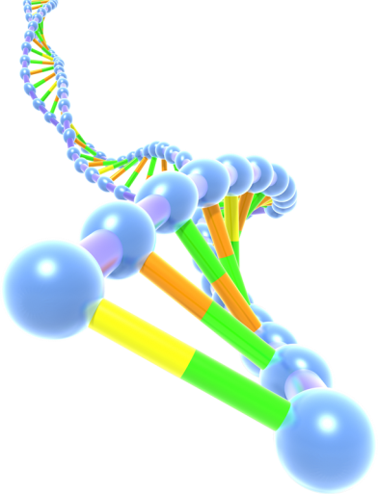
Overview
Item 1
Conclusion-a-phobia
Item 2
Functions of a COnclusion
Item 3
“1 Must” and “3 Ideals”
Item 4
The “5 Avoids”
Item 5
Sample

Slide 3
Conclusion-a-phobia
Often “Feel” conclusos are hard to write.
Non-academic causes.
  Psychologically, you have finished your thesis, so it is hard to write another chapter.
  You are exhausted after two years work
  You are bored with the topic because the interesting discoveries have been made
    BUT
  It is not technically difficult
  It is a short chapter.
Its short.
Its not complicated.
Its motivational writing.

Slide 4
Importance
A second line of text could go here
For grading/Examination
For Longer Term Career
Its the LAST piece the examiner reads.
  They may have read it over weeks
    Bits and pieces
      This piece integrates it all in a few minutes
A good conclusion wil provide you with the energy to publish your thesis when you cme back to recap your findings…after your post-thesis rest

Slide 5
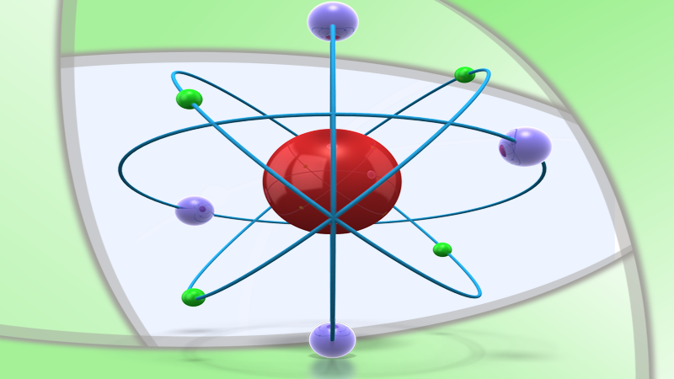
The Five Avoids
Claiming findings that you have not proven
Introducing new data
Hiding weaknesses or limitations in your thesis. (Use a self critique, but don’t go overboard)
Avoid too long (repetitive) or too short (nothing to say)

Slide 6
Sample Conclusion Structure
One paragraph restating what you researched and your original contribution
Then break into sections
One section on what you researche and how you did it
One section on main findings
One section on possble areas of future research
Motivational pitch about applicational use of your findings
Final summary paragraph – motivational and integrative.

Slide 7



The “1 Must” and “3 Ideals”
Must
Make a clear and concise statement of your contribution to knowledge
Aspire to
Show links between key ideas across the chapters
Show your commitment and aspiration to academic research
Leave a positive impression with the examiners

Slide 8
A Theology of Entrepreneurship
A Theology of Creativity
+
A Theology of Management
Leads to a Theology of Innovation
+
A Theology of Faith
Leads to a Theology or Entrepreneurship

