Slide 1
Constructivism
Stephanie Moore
TUL 671

Slide 2
What is Constructed?
Individual knowledge about the world
(Psychology, Education, Learning Theory)
Shared and Accepted Scientific Knowledge about the world
(Sociology, Philosophy, epistemology)
The world is socially constructed”
( Philosophy, and Epistemology )

Slide 3
What is Constructivism
1) Knowledge is actively constructed by the learner, not passively received from the outside. Learning is something done by the learner, not something that is imposed on the learner
2) Learners come to the learning situation (in science etc.) with existing ideas. Some unstable; others are more deeply rooted and well developed.
Learner has their own individual ideas about the world, but there are also many similarities and common patterns in their ideas
4)Teaching has to take the learner's existing ideas seriously if they want to change or challenge these.
5) Learners construct their knowledge through their interaction with the physical world, collaboratively in social settings and in a cultural and linguistic environment.

Slide 4
Theorists
Dewey: Founder of Philosophical Approach
rejected the notion that schools should focus on repetitive, rote memorization
proposed a method grounded in real experience
Paiget: Father of Personal/Psychological Constructivism
rejected the idea that learning was the passive assimilation of given knowledge.
proposed that learning is a dynamic process comprising successive stages of adaption to reality during which learners actively construct knowledge
Vygotsky: the father of Social Constructivism,
He rejected the assumption made by Piaget that it was possible to separate learning from its social context
Proposed social and collaborative nature of learning

Slide 5
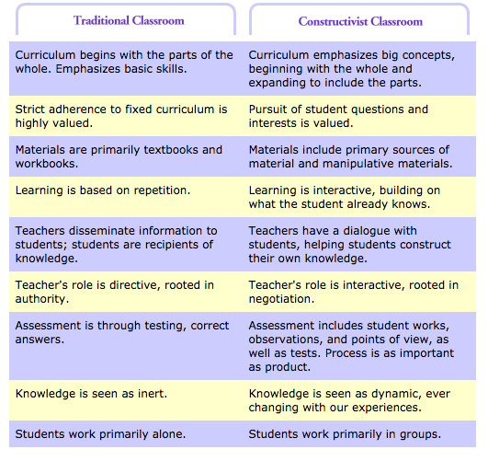

Slide 6
Constructivism roles in Education Context
Students Role: Active Learners
Reflect on and examine his or her current knowledge
Applying their existing knowledge and real-world experience, learn to hypothesize, testing their theories, and ultimately drawing conclusions from their findings
They reflect on their own learning and how there knowledge has changed
Teachers Role: Facilitator
Prior Knowledge: understands the students' preexisting conceptions, and guides the activity to address them and then build on them.
Help students to create their own knowledge
Provides Tools for further learning such as problem-solving and inquiry-based learning activities

Slide 7
Resources
Open Educational Resources of UCD Teaching and Learning, University College Dublin
http://www.ucdoer.ie/index.php/Education_TheoryConstructivism_and_Social_Constructivism
Constructivism and Learning by Svein Sjoberg
http://www.academia.edu/10897308/Constructivism_and_Learning
WNET: Concept to Classroom: Constructivism
http://www.thirteen.org/edonline/concept2class/constructivism/

