Slide 1



Research Thesis/Project
For 18 months you have enjoyed exploring nooks and crannies of conversations among the poor.
MATUL
Now we bring you…
PHILOSOPHY & SKILLS FOR CREATING GREAT RESEARCH THAT INTEGRATES THOSE THEMES INTO ACCEPTED KNOWLEDGE FORMATS
Notes:
To view this presentation, first, turn up your volume and second, launch the self-running slide show.

Slide 2

To View This Presentation
FIRST
Mute Your Volume
SECOND
Leave your video on, so we can actually engage
Notes:
To view this presentation, first, turn up your volume and second, launch the self-running slide show.

Slide 4
What background do you bring?
What do you hope to learn?
What is in your heart to do at this point?

Slide 5
Urban Missions Research
Not a linear philosophical foundation
Entrance & Issue
Theological Reflection
Community Development Research
Social Science Models
Integrated Conversation
Presentation of Research
New Action Steps

Slide 6
1. Action Research
Research for Change
God is a God of Action in History
Kingdom –directed Research

Slide 7
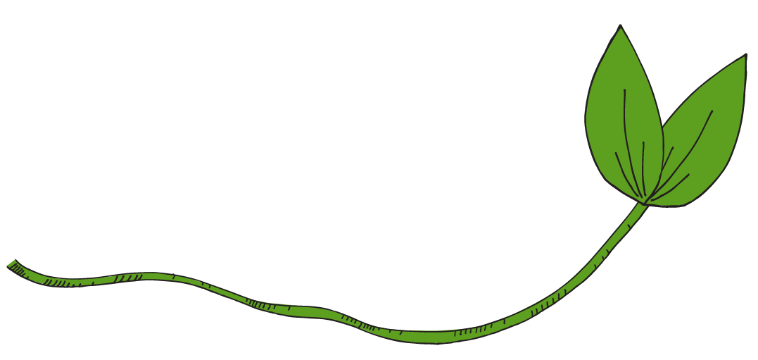













Involve Action
Based on Vision
Based on Insight
Notes:
…global causes.

Slide 8








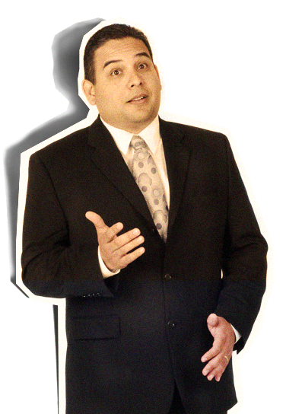

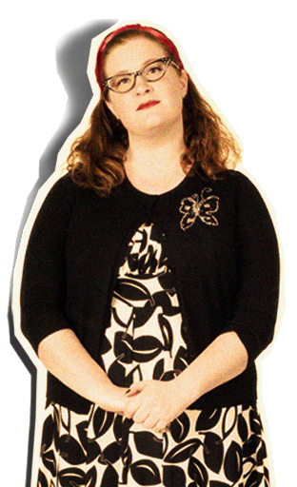

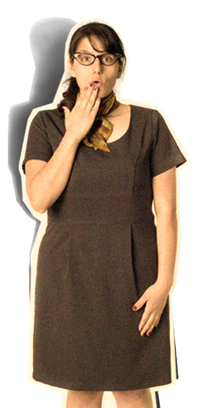
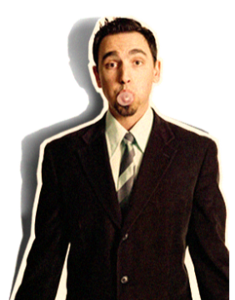
Aim at Changing Minds
Notes:
…and you will undoubtedly find favor with the king.

Slide 9








Notes:
Presentations are a powerful communication medium.

Slide 10

2
SPREAD
IDEAS
AND
MOVE
PEOPLE
Notes:
The second rule is: Spread ideas and move people.

Slide 11
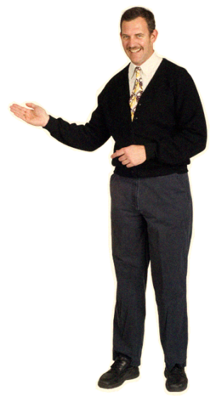
$
Research begins with knowing your decision-makers
With carefully crafted communication
Notes:
Give them those things in a clear, easily understandable way…

Slide 12
BLAH
BLAH
BLAH
BLAH
BLAH
BLAH
BLAH
Notes:
Your audience didn’t show up to read your 60 page on screen dissertation.

Slide 13
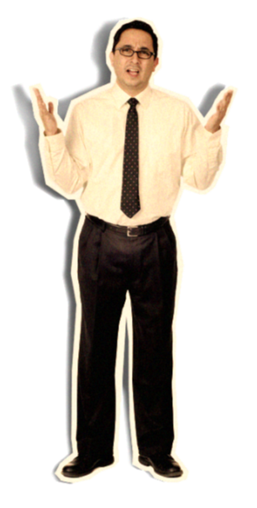
Underlying assumption is that Bob Dylan was wrong
Truth exists
Can be defined
Can be communicated
Notes:
But the question remains—Why go to all this trouble?

Slide 14
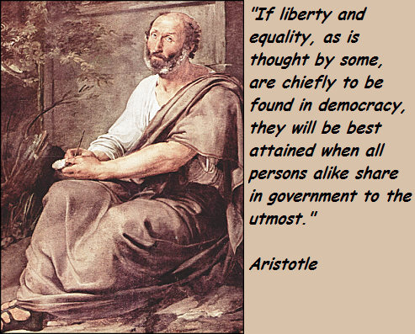
Conversation with History
Aristotle and Plato determine the logic of communication of academic research
Becoming interpreters of the grassroots to those in decision-making roles through accurate ferreting out of the issues and needed directions of change.

Slide 15

RULES
THERE ARE RULES IN ACADEMIA
BREAK THEM AND YOU ARE MINCEMEAT
Learn rules of research design
Learn rules of data collection and analysis
Learn rules of academic communication
Notes:
So there are the rules.

Slide 16
Calendar your deadlines
Discuss where you want to end up and how this piece of published work will help give entrance
Review the Syllabus
Before You Begin

Slide 17
Philosophy
Assessment of Context
Chart the Journey
Ethics
Literature review
Participant Observation
Planning a Proposal

