Slide 1
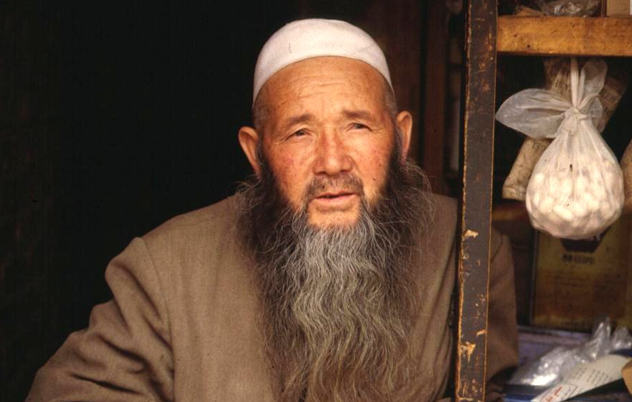
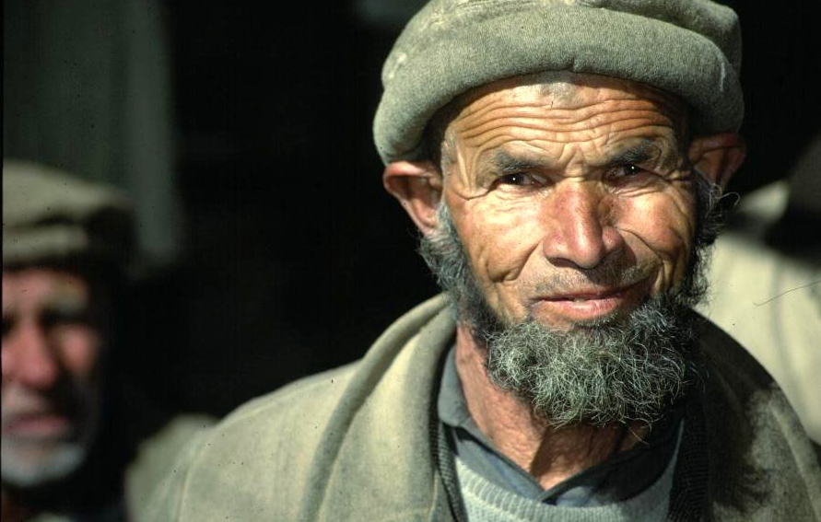
Encarnação Alliance
Bringing Christ’s Love to the World’s Slum-dwellers

Slide 2
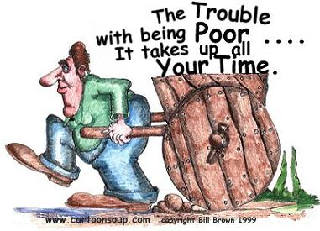

Slide 3
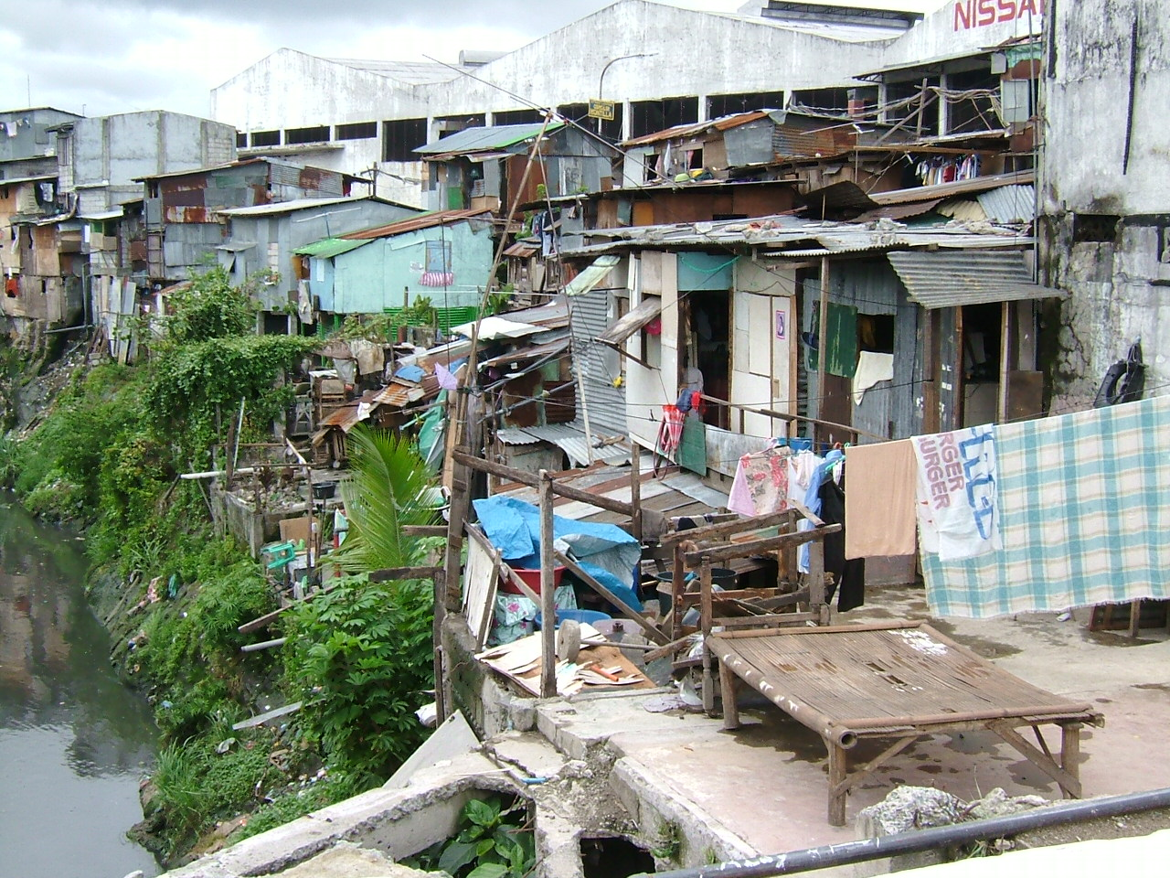
Bridging Privilege and Poverty
Missional Movements Among the World’s Urban Poor
Plant a church here……….

Slide 4
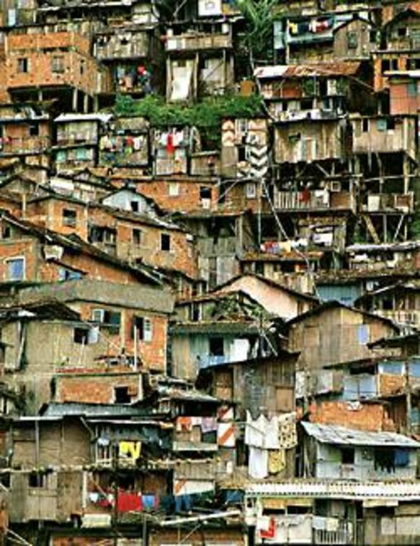
Dispossessed?
1.3 billion people around the globe living in slums, sidewalks, under bridges, on riverbanks, and in garbage dumps.
We need to be demonstrators of the Kingdom of God to the marginalized.
We are in the middle of raising up 50,000 from the slums to the slums
You are invited…go get a taste Then come train in the MATUL

Slide 5
Who are the Encarnação Alliance?
A network of urban poor ministries
From Asia, Africa and Latin America
Incarnational ministry among the poor
Servants, Servant Partners, Kairos,
Movements preparing to evangelize
3,500 cities. Seeking to mobilize 50,000 new cross cultural workers to the slums by 2010.

Slide 6
Encarnação Alliance Vision
The vision of the Alliance is to see churches established that proclaim the Good News of the Kingdom of God among the slum dwellers of the world’s poorest cities and model true Christian living on the example of Jesus Christ.

Slide 7
The Biblical Basis of Incarnation
  John 1:14,18
    He became a human being, and dwelt among us, and we have beheld …glory…grace…truth…
      10 years pioneering in Kolkata, 2 movements,
      A Kolkata Story
  Phil 2:5-8 From God to man to baby to death. Always going down
  I Cor. 9; 22,23
    Becoming all things to all men… yet always preaching good news.

Slide 8
Genesis of the Alliance

Slide 9
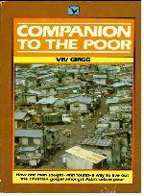
Viv Grigg, Following the Holy Spirit, 1974-94
Intercession / Prophetic Catalyzing of Incarnational Works
Korean
Tamil, 06
Servant-Partners, 85-87, 89, 92,00-02
Bangkok, 84
Kolkata, 83-94
Manila, 74-85
Spanish
Portuguese
Kairos, Sao Paulo, 87-89
New Zealand Servants base, 81-85
Build like a master builder on Christ who is the foundation
I have used Urban Leadership Foundation as the organisational base for this.

Slide 10
Expansion of Servants to Asia’s Urban Poor
In Manila, 54 works have been formed
UK Base, 87-
Swiss Base, 89-
Canadian base, 06-
Kolkata
Dhaka
Delhi
Phnom Phen, 89-
Bangkok, 83-00
Manila, team 81-
Banda Aceh, 05-08
Australia base, 86-
New Zealand base, 81-

Slide 11
Expansion of Servant-Partners
Cairo
LA base
Kolkata
Mumbai
LA base
North Africa
Mexico
Addis Ababa
Bangkok
Guadalajara
Nairobi
Manila,
Caracas

Slide 12
Expansion of Brazilian mission, Kairos
Kolkata
Macau
North Africa
Dhaka
Mexico
Central America
Senegal
Caracas
Manila
Mozambique
Lima base
Kairos, Sao Paulo, 87-89

Slide 13
Explosion of Other Incarnational Missions
Urban Trek
Romania
Naga Mission, 05-
Innerchange
St Stephens Society
Kolkata
Word Made Flesh
Hong Kong
Cairo
Addis Ababa
Mexico
Nairobi
Dhaka
Bangkok
Church Missionary Society
Manila
Caracas
Lima
Siervos
UNOH
We developed the Encarnacao Network to link these, and share training
Some of these form churches, others are prophetic, others do development

Slide 14
Encarnacao Alliance
Grassroots Learning Networks
Storytelling
12 modules
55 topics
On CD
10 paradigm shifts

Slide 15
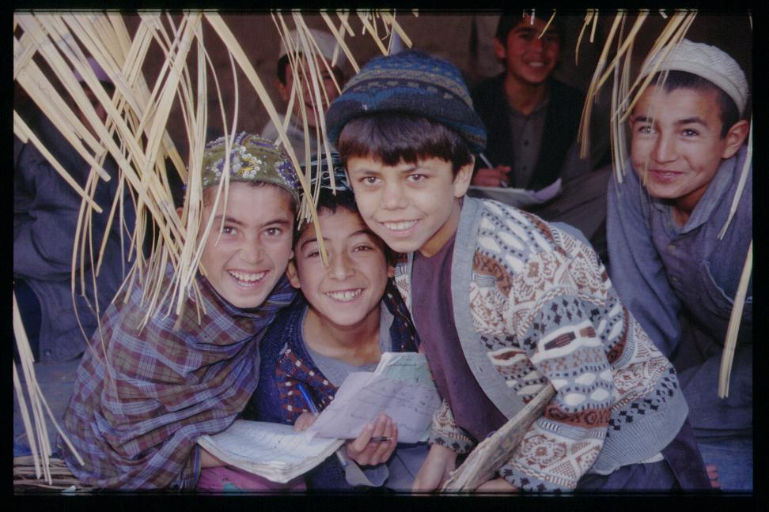
A commitment to ten Church planting principles
A willingness to suffer, to endure and to die
Cross-cultural proclamation among the unreached
Passionate, Focused Evangelism
Working in Teams
Long Term incarnational ministry
Working in Partnership
Avoid Dependency
Critical contextualization
Women in Ministry
Leadership Development

Slide 16
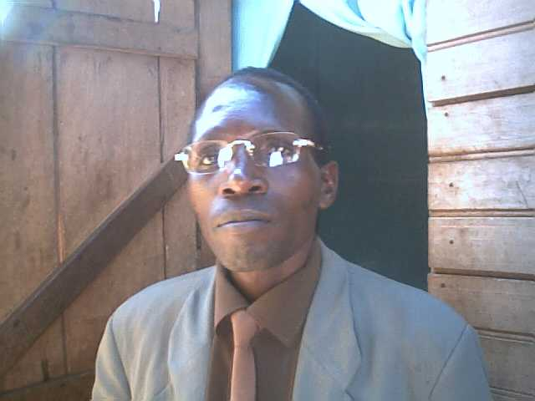
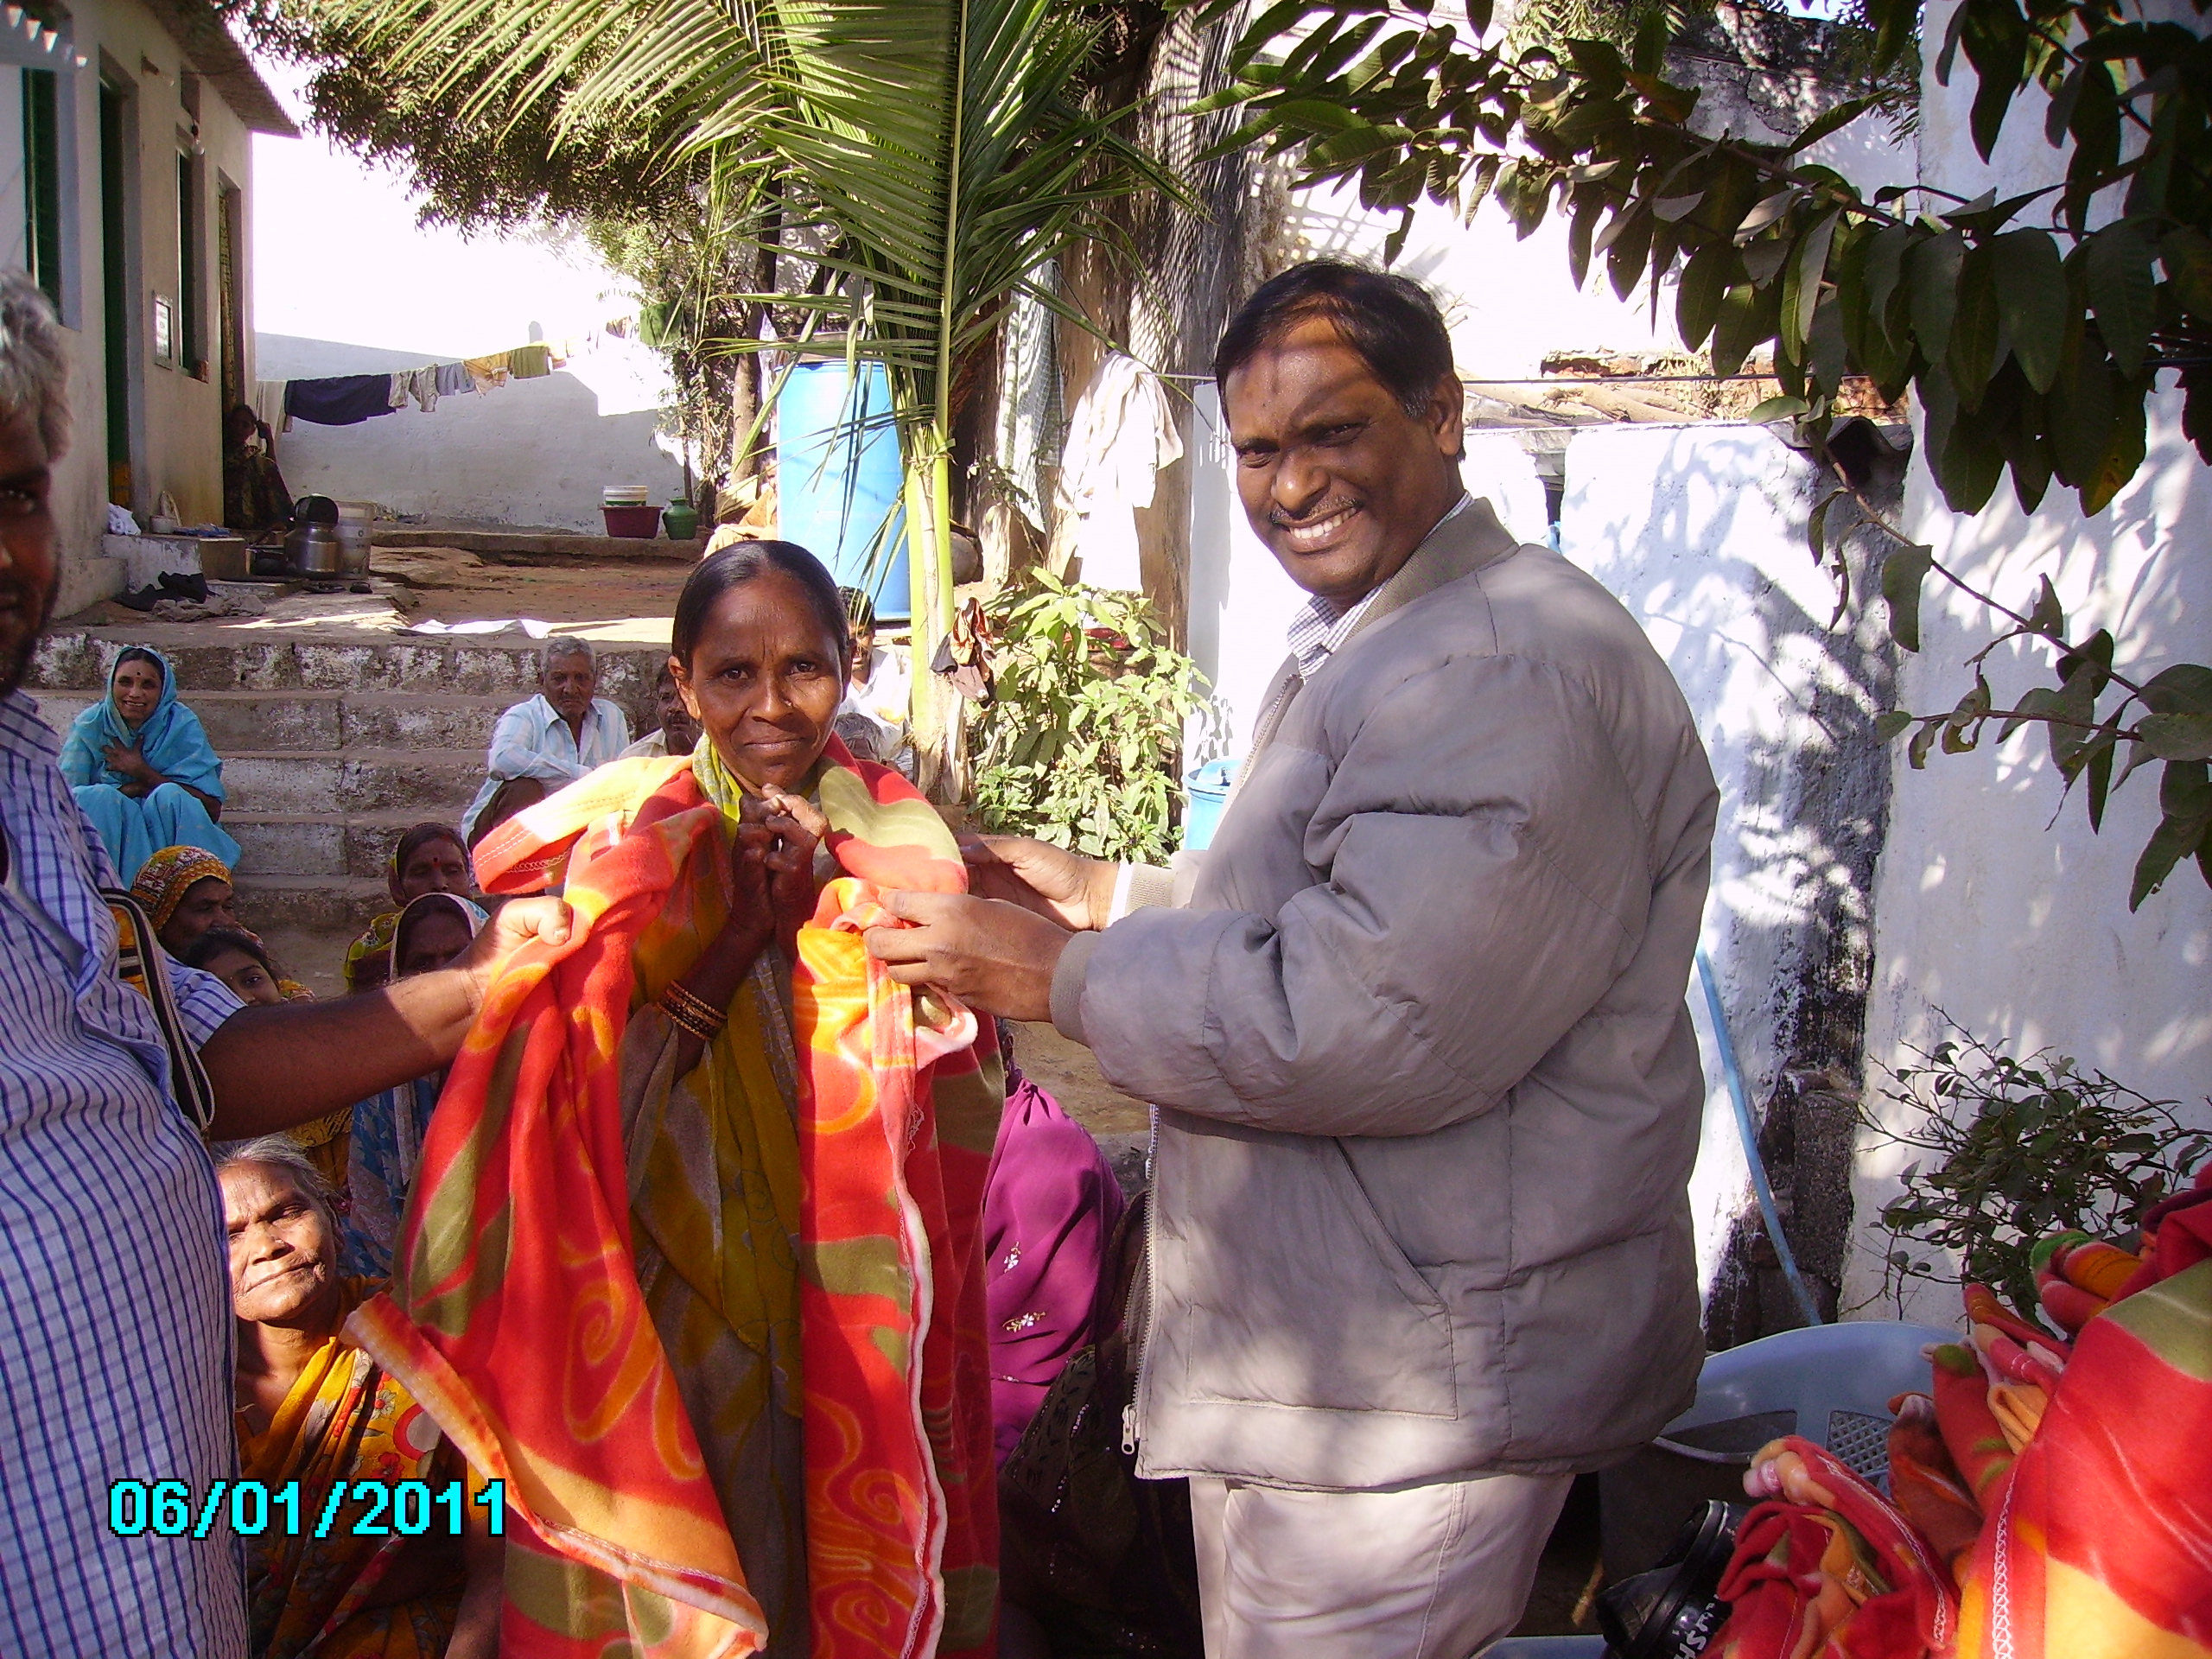
Find the Man or Woman of Peace for City
Matt 10

Slide 17
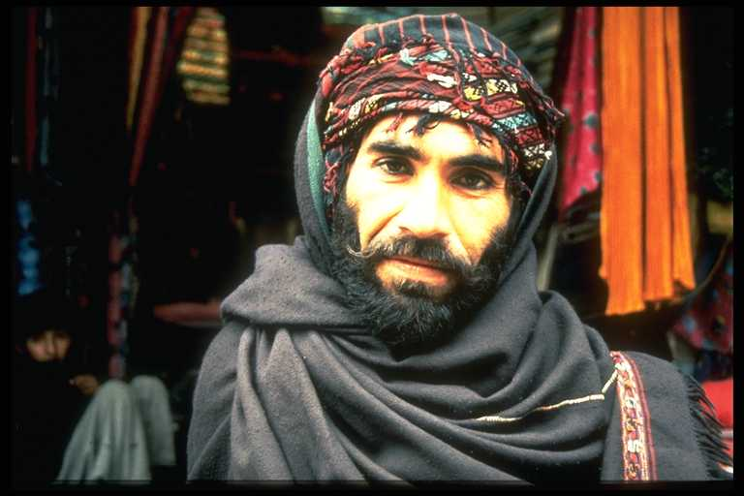
A willingness to suffer
“God’s finest tool in our lives is the tool of suffering”. Corrie Ten Boom.
Once broken and once renewed we are better equipped to understand others and to reach others

Slide 18
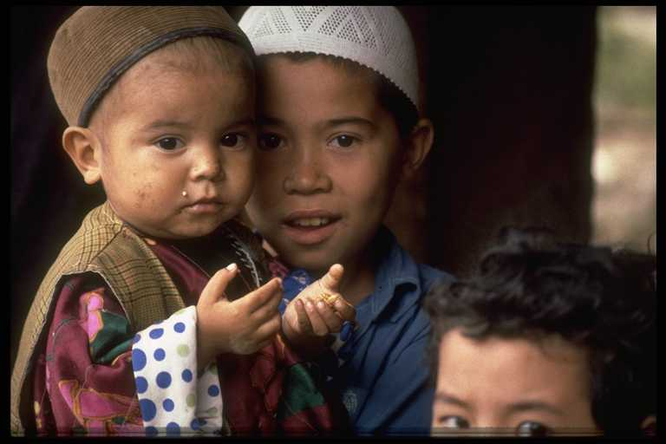
Suffering and Endurance
”For just as the sufferings of Christ flow over into our lives, so also through Christ our comfort overflows” The Apostle Paul in 2 Corinthians 1:5

Slide 19
Passionate, focused, evangelism
Involves story telling and drama
Community building
Utilization of mass media & technology for Gospel communication
Accessibility to the Scriptures
Slum based presence
” If I am lifted up, I will draw all men to myself “ John 12:32

Slide 20
Working in Teams
  Team ministry is Biblical & it enables individuals to be more effective
  Creating Church planting movements
  Strength in diversity
  Spiritual gifts & natural abilities helps Gospel effectiveness
  Support & encourage one another
  Teams need to take risks & not just operate in one’s own comfort zone

Slide 21
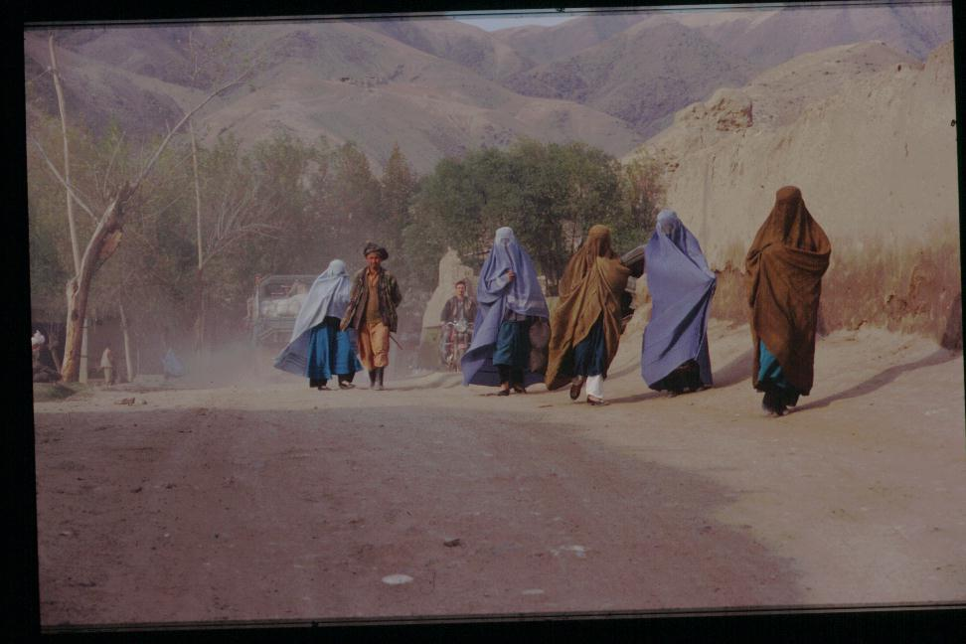
Women in ministry and the community
Empowering women to learn language & invest time with women
Provide increased quality care for women
When women are involved the Church grows
Women are vital to community communication
Develop women theologically and in leadership

Slide 22
Leadership Empowerment
Leadership empowerment of team members and movements
Aiming for early transfer of leadership responsibilities
Teaching & modelling servant leadership
Leadership understood and done in a culturally appropriate way

Slide 23
The planting of Churches will bring salt and light into the community.
Salt is to preserve what is good and add flavor. Matt 5:13
Salt is good. Mark 9:50
Let your speech always be seasoned with grace, as it were with salt, so that you may know how to respond to each person.
Col. 4:6
If salt loses its flavor how will it be salty again? Mark 9:50
You are the “light” of the world, a city set on a hill cannot be hidden. Matt 5:14
Walk as children of light. Eph. 5:8
If we walk in the light as He Himself is in the light, we have fellowship with one another and the blood of Christ cleanses us from all sin.
1 John 1:7

Slide 24
Uganda: 3 Paradigms for Slum Church Renewal
The Role of Deacons
10 Principles of Economic Discipleship
Pastors are to train others to do the work of he ministry (Eph 4: 11, 12)

Slide 25
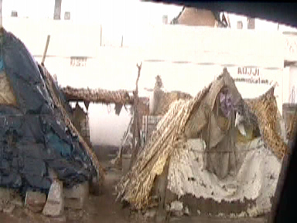
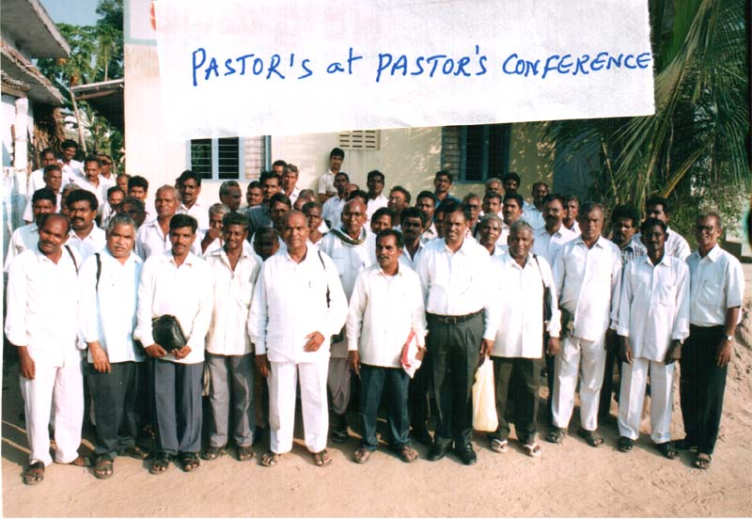
Hyderabad
Indigenous Multiplication
Based on Holy Spirit,
Sacrificial Lives and Training
How do you become part of what God is doing?
Partnering churches
Partnering individuals

Slide 26

MA in TRANSFORMATIONAL URBAN LEADERSHIP
Movement Leadership training

Slide 27
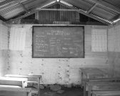
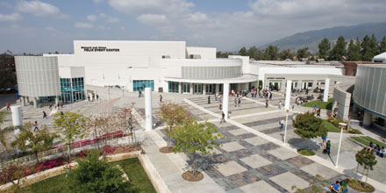

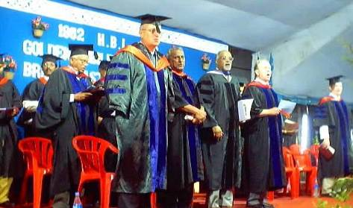
Collaboration in a Global MA in Transformational Urban Leadership
Azusa Pacific University – a resource base
Centre for Urban Mission, Nairobi
Hindustan Bible Institute, Chennai, India
15 other schools enquiring

Slide 28
