Slide 1

Family Stresses in the Urban Ministry
Genetics is a hand of wild cards
You take the hand you are dealt and turn it into a process of delight
It’s a skill, an art, a symphony of chaos, cacophony and great harmonies of emotion, will and wisdom

Slide 2
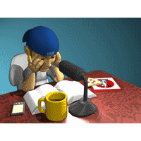
1. Introduction
(1) Unity of marriage is a central goal in life, reflecting the very unity of the Godhead.
(2) Paralleling that but not preceding it, marriage is a foundation for effective ministry. Fatherhood is the central dynamic in pastoring the flocks God gives and birthing new flocks.
(3) Both dedicated singleness (linked to supportive community) and missionary family life are gifts of God.
(4) In the midst of urban missions pressures families need to survive and develop healthily.

Slide 3

2. Family Lifestyle in a Modern Society IS Stressful in Itself
(1) Yet marriage with its joys is itself is a stress. (1 Cor. 7:33,34 ) A married man's interests are divided.
(2) Today we also face an increased pace of life
(3) Multiple roles in any society are changed as we move across cultural barriers - the many hats are multiplied.
(4) Marriage commitment is under fire
(5) Yet we must build together Christian values

Slide 4
3. God's Urban Call to the Couple
(1) Both need to be called, for co-working in marriage involves leadership by the husband but is based on consensus and harmony.
(2) At times we need to wait for the other.
(3) At times we need to moderate goals for the other.

Slide 5
4. The Goldfish Bowl: Marriage as a Witness to the World
(1) Marriage is a sign to the nations of the unity of Christ and the church (Ephesians 5:23,24).
(2) Leaders are always under inspection (1 Timothy 3:2-5).
(3) This stress leads us to perfectionism, yet we need to be gentle with ourselves, laugh at ourselves, and demonstrate the grace of God that covers our failures and sins.

Slide 6

5. Marital and Working Roles
(1) Support for the husband's role at times may mean the wife gets lost in the new situation.
e.g. In Muslim cities the wife rarely can go out in public. If she has been an executive or professional woman prior to going to that city it can be a devastating role change.
(2) Support for the wife's needs particularly during transition and during the pressures of early child-raising years, may mean the husband loses out in the drive to accomplish. Sometimes the choice is to reduce workload from 55-60 hours per week (normal in ministry) to 35-40 hours for seasons with a subsequent loss of goals, and leadership ability.
(3) Avoiding stagnation during the child-raising years, or in a city where the wife must remain in the home. There is a fear of mental stagnation. It is important to find some identity by some outside commitments.

Slide 7

6. Ministry and Marital Realities
(1) Changes in sexual patterns occur with the long hours establishing a new home in a new city while sustaining the ministry.
e.g. language learning and its emotional damage, orienting new workers in the home use up emotional energy and late night hours.
e.g. discussing a new work assignment at night - she wants to sleep in order to cope with the new things and the children. He feels she does not love him anymore and does not care about unity in the work
(2) The physical situation may not be ideal - sleeping in the same room with young children, paper-thin walls, curious neighbours hinders intimacy.
(3) Some societies do not permit the public show of affection to the same extent. We need to learn alternate ways - notes, flowers.
(4) Separation for long periods brings extra pressures. Top missions leaders seems to have a consensus that three weeks is maximum for global travel.

Slide 8
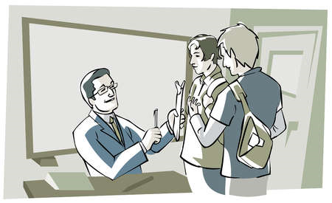
7. Chosen Simplicity vs. Enforced Poverty
(1) We choose to follow Jesus' teaching on simplicity, on trusting him to provide, putting first his Kingdom.
(2) But at times the desire to have more than just the basic needs becomes too strong for one or the other partner to handle well. The mall beckons.
(3) At other times, while chosen simplicity or non-destitute poverty is a fine ideal, enforced poverty damages the soul and causes major husband-wife tensions. Ministry goals have consumed too much of the month’s income.
(4) The elder who rules well, especially in preaching and teaching, is worthy of double honour. But not all in ministry rule well and are worthy of support. Often those without quite the capacity to rule well, choose to go on living "by faith" and the support is not there. We are live by faith and works.
(5) At other times we go back to tent-making and carry the pressures of three jobs - work, the ministry, and our non-existent secretary's workload.

Slide 9

8. The Loss of the Extended Family and Failures of the Missions Community
(1) God did not intend nuclear families independent of the extended family. But we are called as nuclear families, to leave father and mother for the sake of building a new community.
(2) His promise is that he replaces these relationships with new ones in the family of God. However the new relationships may not always provide the grandmotherly love or the deep friendship or the carer who comes with cooked meals.
(3) There is loneliness, hardship, long hours.

Slide 10

9. The Joys And Pain Of Urban Ministry
(1) What can match the thrill of working with your daughter to give some food to an old drunkard and watch his response.
(2) What better way to walk with your children than to constantly be in discussion with them about the people filling your house and how to love them.
(3) What a catastrophe to raise children in a quiet suburb away from the realities of seeing the word of God bear daily fruit.
(4) Yet there is no safe place for her to play unless you go with her, and she learns such foul behavior from the neighbors kids which takes years to modify.

Slide 11
10. Children's Education
(1) Home schooling? Boarding School? Public school?
(2) Christian School across the city?
(3) Kids with special needs?

Slide 12
Resources

