Slide 1
MA in TRANSFORMATIONAL URBAN LEADERSHIP
Azusa Pacific University
Dr. Viv Grigg, International Director

Slide 2
Peacemaking begins in being one of the people
HOME
⏎

Slide 3
Dispossessed?
1.3 billion people around the globe living in slums, sidewalks, under bridges, on riverbanks, and in garbage dumps.
We need to be demonstrators of the Kingdom of God to the marginalized.

Slide 4
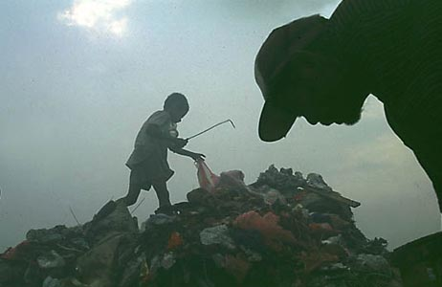
What is transformational urban leadership?
MOVEMENT LEADERSHIP
Entrepreneurial or apostolic leadership generates:
movements of poor people’s churches
economically engaged disciples
activists in the struggles for justice
catalysts in transforming poverty
Picking garbage in Payatas

Slide 5
Jesus trained in action
DELIVERY
PROCESS
CHARACTER
AND
SPIRITUALITY
The God of action is known in action
Theology – entering into the revelation of God occurs through following where he is (John 12-24-26)
Each course 1/3 action, 1/3 theology, 1/3 social analysis

Slide 6
Getting Jesus’ Seminary into the Slums
Holistic spirit centred wisdom not linear logic Socratic in approach
Began in prayer and empowerment
Then in caring, healing the marginalised
Teaching the scriptures in the midst of poverty
Dealing with realities
Formed church,
Movement Leadership
Advocacy
Education
Health Care
Has to grow in ability to interface with modernist Socrates in papers & final thesis or project

Slide 7
YEAR 1
Semester 1 |  | Semester 2
TUL 500 | Writings, Reign and Urban Realities | TUL 540 | Urban Reality and Theology
TUL 505 | Language and Culture Acquisition | TUL 550 | Service to the Marginalized
TUL 520 | Urban Spirituality | TUL 555 | Educational Centre Development
TUL 530 | Building Faith Communities | TUL 560 | Theology & Practice of Community Economics
TUL 570 Field Supervision I
YEAR 2
Semester 1 |  | Semester 2
TUL 620 | Leadership in Urban Movements | TUL 640 | Entrepreneurial @ Organizational Leadership
TUL 630 | Community Transformation | TUL 655 | Advocacy and the Urban Environment
TUL 650 | Primary Health Care | TUL 670 | Research Project or Thesis
TUL 660 Field Supervision II

Slide 8
How Do You Learn Leadership?

Slide 9
Who should join this program?
What kind of career can I get?
Urban Ministry: Those with experience in urban ministry churchplanting and church-based development
Demonstrated Leadership: Those wishing to become change agents among the urban poor cross culturally
Advocacy: Those who may end up in advocacy but need to understand the insides of poverty in order to be effective
Movement Leadership
Theologian
Philosopher
Professor
Entrepreneurial Church Developer
Small Business Entrepreneur
Non-Profit Leader
Social Worker

Slide 10
A Global Degree: MATUL Partners
A program in partnership with The Encarnação Alliance, an international network of urban poor leaders and scholars
Asian Theological Seminary in Manila, began July 2007
Hindustan Bible Institute in Chennai, India began June 2007
Azusa Pacific University in Los Angeles began April 2010
Carlisle College in Nairobi, June 2011
Mission India, Nagpur, June 2011
Univeriste Episcopale d’Haiti (in French), Oct 2010
A web-based process for field-based teams late 2012
www.urbanleaders.org/ma

Slide 11
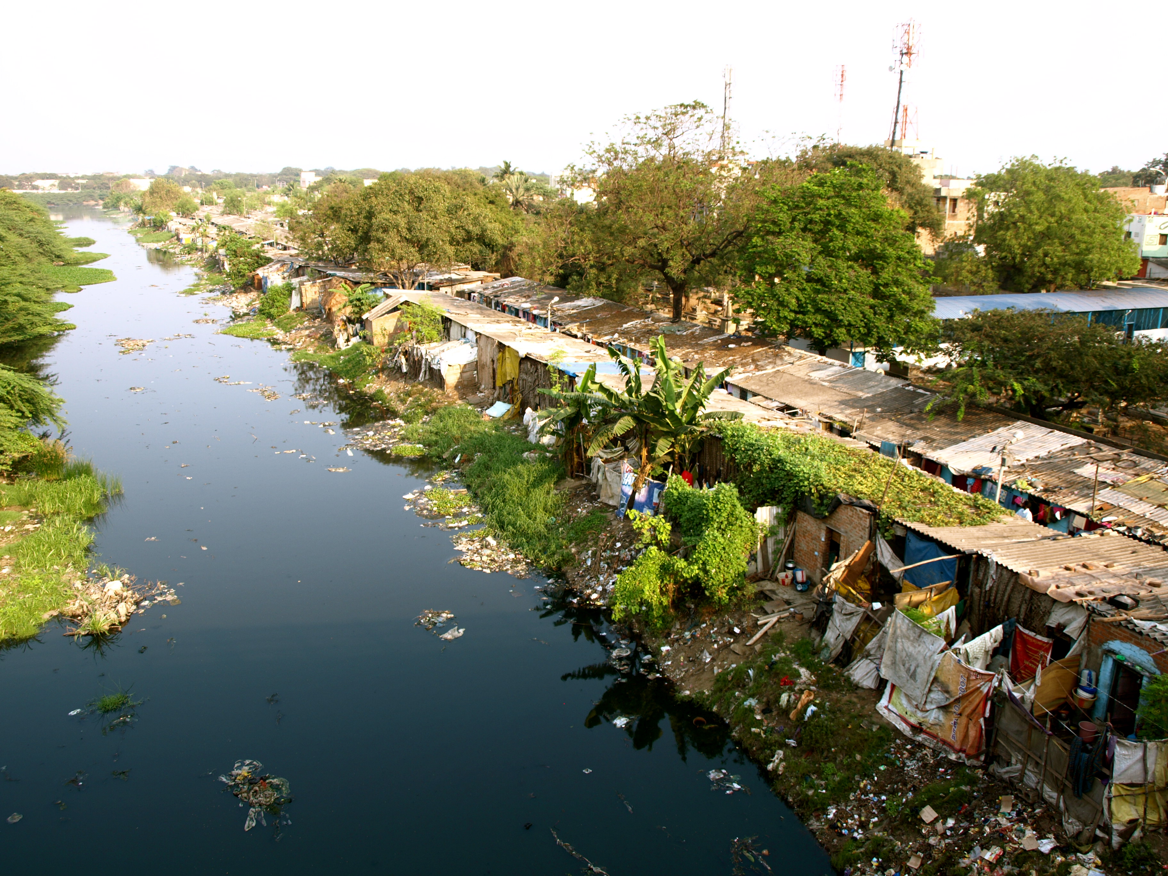
What are the costs for the degree?
APU cost for degree
$340/unit = $15,600
Plus airfares, language school, accommodation
What is the Schedule?
First Class begins downtown LA in Sept
Language Study begins in January
in the Philippines
in India
in Haiti ??
in Kenya

Slide 12
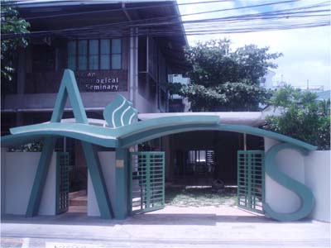
Asian Theological Seminary
Our mission is to glorify God by providing
quality theological education to prepare leaders who will effect biblical transformation in the Church and societies in Asia and beyond.
Campus: 54 Scout Madriñan, Quezon City, Philippines
Mailing Address: QCCPO Box 1454-1154
Quezon City 1102, Philippines
ATS Phone: (632) 928-6717 Loc 125, Fax: (632) 928-5114
Center for Urban Transformation Phone: (632) 928-5097
Program Director: Dr. Lee Wanak/ L_Wanak@yahoo.com
Program Assistant: Nelson Gaurano/ nelson@ats.ph
Chair, Encarnação Alliance Training Commission:
Dr. Corrie DeBoer/ stewcorrie@yahoo.com
General E-mail: info@ats.ph

Slide 13
Hindustan Bible Institute
HBI exists… To give every person an opportunity to hear, understand and respond to the Gospeland to be discipled into communities of believers.
Vision We want to see a dynamic transformational church in every village and colony of every town and city of India!
Campus: HBI Ministries (India) 86-89 Medavakkam Tank Road Kilpauk, Chennai 600 010 TamilNadu, India Phone: 91-44-2642 1199/1975/3664 Fax: 91-44-2642 3664 E-Mail: info@hbionline.org
Principal: Dr Isac Raja Soundaraj, principal@hbionline.org
Program Director: Dr. P.N. Saravanan, pn_saravanan@yahoo.com
Program Assistant: Grace Nithya, grace_nithya@yahoo.com

Slide 14
Asuza Pacific University
This program will be delivered entirely as a field based program at our partner schools overseas
Begins Feb 2011
Contact:
Dr Viv Grigg, vgrigg@apu.edu
Dr Rich Slimbach rslimbach@apu.edu
Or Rebecca Pratt rpratt@apu.edu

