Slide 1
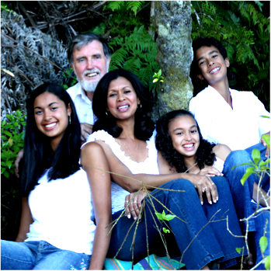
Personal Pilgrimage
Heliopolis, 1988
Following Christ Living in the Slums & Favelas of * Manila, Philippines * Kolkata, India * Heliópolis, São Paulo
In answer to prayer, God has given * movements of thousands of churches,
200+ development agencies, advocacy groups
7 missions
4 global networks which include the Aliança Encarnação de Lideres de Movimentos entre os Pobres
Training processes

Slide 2
Peacemaking begins in being one of the people
HOME
⏎

Slide 3
TRANSFORMATIONAL URBAN LEADERSHIP
An International Partnership of the Encarnacao Alliance of Slum Movment Leaders
www.urbanleaders.org/ma for structure
www.urbanleaders.org/matul for course designs
www.matul.org for PR site
Dr. Viv Grigg, International Chairman, MATUL Training Commission

Slide 4
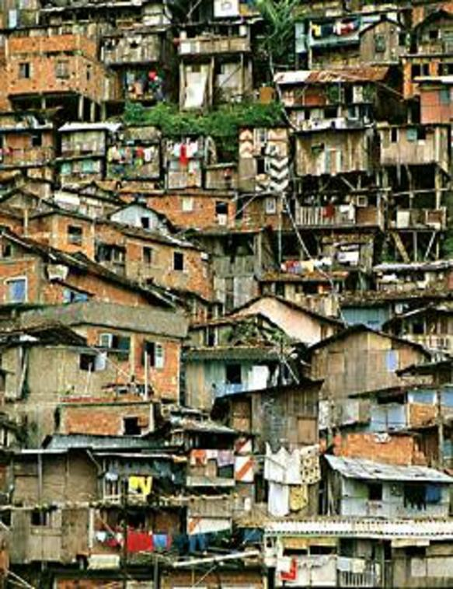
Dispossessed?
1.3 billion people around the globe living in slums, sidewalks, under bridges, on riverbanks, and in garbage dumps.
We need to be demonstrators of the Kingdom of God to the marginalized.

Slide 5
The village has moved to the city
99% of Chennai’s migrants are from North India
16,000 people per day migrate to Chennai
The largest people group in the world are the 1.4 billion slum dwellers.

Slide 6
His Purposes Begin in Proclamation Among the Poor
The Spirit of the Lord
Is upon me
Because the Lord
Has anointed me
To preach good news
Among the poor
He has sent me
To proclaim freedom for the prisoners
And recovery of sight for the blind
To release the oppressed
To proclaim the year of jubilee.
Some of the first believers in Tatalon, Manila
Notes:
Tell you a story from when I was 25.
Preaching in Marios house
TAKE OFF SHOES

Slide 7
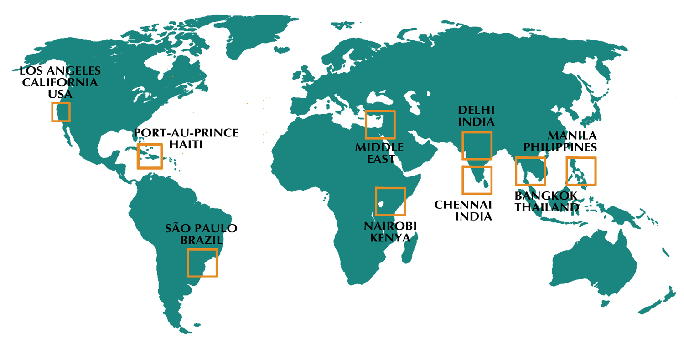
Global Degree: MATUL Partnership Sites

Slide 8
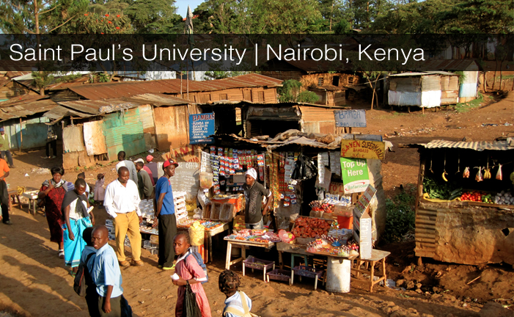
Global Collaboration

Slide 9
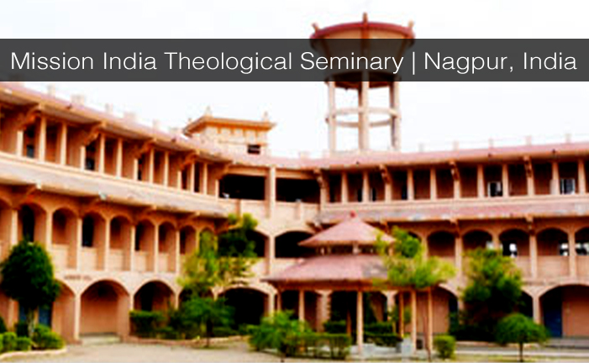
Global Collaboration

Slide 10
New Sites for 2013
Rio de Janerio, Brazil
New African Partners
Uganda Chrisitan Univerity
Addis Ababa, Ethiopia
Accra, Ghana
Asian Theological Seminary has responsibility
To laucnh in Indonesia, Cambodia, South East Asia

Slide 11
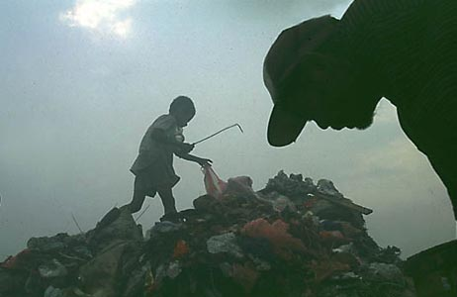
What is transformational urban leadership?
MOMENTUM
ENVISIONING
MOVEMENT LEADERSHIP
TEAM BUILDING
SPECIALIST EXPERTISE
Entrepreneurial leadership generates:
movements of poor people’s churches
economically engaged disciples
activists in the struggles for justice
critical catalysts in transforming the poverty
Picking garbage in Payatas

Slide 12
MATUL Learning Domains
Culture Studies
Urban Church Growth
Community
Transformation
Movement
Leadership
Urban Spirituality
and Theology
Small Business and Organizational Development
Specialist Disciplines: Slum Schools, Health
Programs, Marginalized, etc.

Slide 13
ACTION
THEOLOGICAL REFLECTION
SOCIAL ANALYSIS
DELIVERY
PROCESS
CHARACTER
AND
SPIRITUALITY
Each course 1/3 action, 1/3 theology, 1/3 social analysis

Slide 14
How Do You Learn Leadership?
MENTORING
in spirituality
in church growth
TEACHING
By practical theologians
By practitoners
ACTION AMONG THE POOR
Supervised Internships
in entrepren- eurial business skills
in movement leadership
in organizational leadership
By social scientists
STUDY AND RESEARCH
Reflections on global and local literature
Research paper
in the community
in the NGO's
in the churches

Slide 15
YEAR 1
Semester 1 |  | Semester 2
TUL 500 | Writings, Reign and Urban Realities | TUL 540 | Urban Reality and Theology
TUL 505 | Language and Culture Acquisition | TUL 550 | Service to the Marginalized
TUL 520 | Urban Spirituality | TUL 555 | Educational Centre Development
TUL 530 | Urban Poor Churchplanting | TUL 560 | Theology & Practice of Community Economics
TUL 570 Field Supervision I
YEAR 2
Semester 1 |  | Semester 2
TUL 620 | Leadership in Urban Movements | TUL 640 | Entrepreneurial @ Organizational Leadership
TUL 630 | Community Transformation | TUL 655 | Advocacy and the Urban Environment
TUL 650 | Primary Health Care | TUL 670 | Research Project or Thesis
TUL 660 Field Supervision II

Slide 16
Content of each course
Is it balanced?
Theology
Social Analysis
Praxis
Centre
Church
Word
Spirit

Slide 18
Community Outcomes
Community Outcomes
YEAR 1: Students and teams start a small group or ministry
YEAR 2: Students and teams start 3 small groups or ministries
YEAR 3: Continuation after graduation to establish a new faith community or specialist ministry

Slide 19
Who should join this program?
What kind of career can I get?
Urban Ministry: Those with experience in urban ministry churchplanting and church-based development
Demonstrated Leadership: Those wishing to become change agents among the urban poor cross culturally
Advocacy: Those who may end up in advocacy but need to understand the insides of poverty in order to be effective
Movement Leadership
Theologian
Philosopher
Professor
Entrepreneurial Church Developer
Small Business Entrepreneur
Non-Profit Leader
Social Worker

Slide 20
A Degree in Social Entrepreneurship
TUL 630 Community Transformation – Develop skills in Community Mapping and then being able to initiae a seed project with the church or community.
TUL 550 Forming New Faith Communities – linking Churchplanting and Economic Discipleship
TUL 640 Entrepreneurial & Organizational Leadership – basic business management applied to an NGO environment
5 Internships with NGO’s– working inside learning basic skills but also evaluating structure of NGO’s funding, administration, financial accountabitilies
TUL 555 Educational Centre Development
TUL 560 Theo & Practice of Community Econ
TUL 530 Service to the Marginalized
TUL 555 Educational Centre Development
TUL 655 Advocacy and the Urban Environment
TUL 650 Primary Health Care
Integration
TUL 670a,b Research Project or Thesis – Evaluation of an Organization leading to a projected plan for organization or movment over the next two years. Requires business plan, financail plan, funding plan.

Slide 21
A Degree in Urban Theology
Urban Reality
Biblical Theological Analysis
Social Analysis
Possible Progressions Academically
Educator
PhD
DMin
Professional Pastor
MDIV
Cross Credit 30 units
Overseas
MATUL
Transformational Conversations
Action-reflection Theological Process
A Way of Doing Oral Theology
1/3 of each course is story-based theology

Slide 22
A Degree in Global Studies
A degree in Community Development

Slide 23
A Degree in Justice Making
And philosophy, and social work, and ….

Slide 24
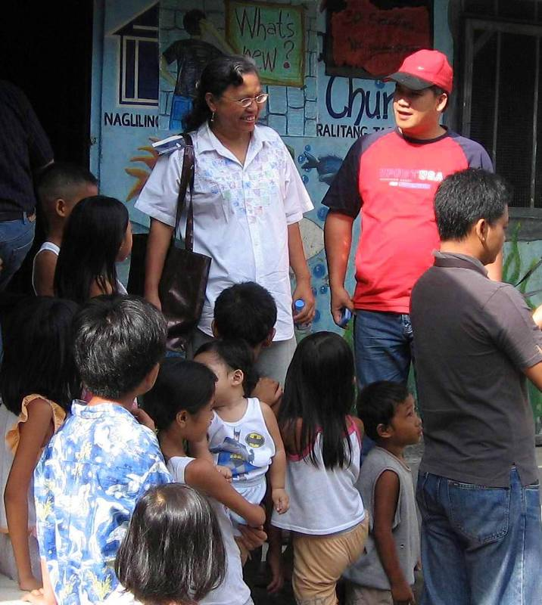
MATUL Leadership
Encarnação Alliance Coordinator, Dr. Viv Grigg, international director of MATUL at APU,
lived in the slums of Manila, Calcutta and Sao Paulo. (Get his book, Companion to the Poor for core elements of this program).
Dr. Corrie DeBoer is the Chairperson of the Encarnação Alliance Training Commission
she started 500 slum schools
Peter Nistche is Program Director at Asian Theological Seminary in Manila
Dr. Isac Raja is Principal of HBI in Chennai, , India (he trained 5000 churchplanters). Dr Saravanan directs the program.
Dr. Rich Slimbach is academic director for Azusa Pacific University in Los Angeles
Dr Colin Smith trains 50 slum pastors in Nairobi slums each year in a Centre for Urban Mission in the Slums
Pere Oge Beauvoir directs the program at UNEPH, Port au Prince, Haiti
Dr Aseervedam directs program at RIMI, Nagpur
Corrie and students in Welfareville

Slide 25
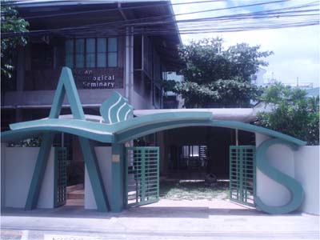
Asian Theological Seminary
Our mission is to glorify God by providing
quality theological education to prepare leaders who will effect biblical transformation in the Church and societies in Asia and beyond.
Campus: 54 Scout Madriñan, Quezon City, Philippines
Mailing Address: QCCPO Box 1454-1154
Quezon City 1102, Philippines
ATS Phone: (632) 928-6717 Loc 125, Fax: (632) 928-5114
Center for Urban Transformation Phone: (632) 928-5097
Program Director: Dr. Lee Wanak/ L_Wanak@yahoo.com
Program Assistant: Nelson Gaurano/ nelson@ats.ph
Chair, Encarnação Alliance Training Commission:
Dr. Corrie DeBoer/ stewcorrie@yahoo.com
General E-mail: info@ats.ph

Slide 26
Hindustan Bible Institute
HBI exists… To give every person an opportunity to hear, understand and respond to the Gospel and to be discipled into communities of believers.
Vision We want to see a dynamic transformational church in every village and colony of every town and city of India!
Campus: HBI Ministries (India) 86-89 Medavakkam Tank Road Kilpauk, Chennai 600 010 TamilNadu, India Phone: 91-44-2642 1199/1975/3664 Fax: 91-44-2642 3664 E-Mail: info@hbionline.org
Principal: Dr Isac Raja Soundaraj, principal@hbionline.org
Program Director: Dr. P.N. Saravanan, pn_saravanan@yahoo.com
Program Assistant: Theopholous, grace_nithya@yahoo.com

Slide 27
Asuza Pacific University
This program will be delivered entirely as a field based program at our partner schools overseas
Begins Feb 2010
Contact:
Dr Viv Grigg, vgrigg@apu.edu
Dr Rich Slimbach rslimbach@apu.edu
Or Rebecca Pratt rpratt@apu.edu

Slide 28
Carlile College, Nairobi, Kenya
An Anglican training college. Moved into the slum of 800,000 people, Kibera, and each year has trained 54 pastors. Now developing the MA to launch next September 2011

Slide 29
Universite Episcopal d’Haiti
Port au Prince, Haiti, will launch October, 2010. The University collapsed in the earthquake and many students died. They are eager to move ahead.

Slide 30
Mission India Theological Seminary
Nagpur, India,
Will launch MATUL, Sept 2011
∧

Slide 31
How does MATUL differ from other degrees?
An Entirely New Field: Urban Poor Movement Leadership
A Leadership Degree
Movement Leadership (evang/apostolic leadership centre) vs Management for NGO ‘s (diaconal centre)
this is not an MBA
Urban Poor Leadership (This is an urban degree)
A Movement Leadership Degree vs a Development Degree
Why? Theologically - Jesus came to train movement leaders (apostles). Deacons/managers were in support roles
His style was holistic mission with a centrality of evangelism, not holism based on Western fundraising (cf. Valdir Steuernagals reflections at WEA on failure of holism in contrast with holistic mission)
Urban Poor Leadership
There is no formal training for these leaders globally

Slide 32
Core Theological Concepts Behind the Degree
The Kingdom of God as core theological framework
Holistic church-planting as central vehicle for Kingdom development
The spiritual is central
to economic, social and justice Kingdom dimensions
The Church, the Word, the Spirit are the Primary Agents of Transformation
International Diaconates are to serve the advance of the incarnational church
Story-telling
Is the primary methodological process of doing theology among the poor (though at an MA level meshes with linear Western logic in the integration paper)
Incarnational
requires students to relocate to slums for large portions of the degree

Slide 33
How does MATUL differ from other degrees?
An Entirely New Field: Urban Poor Movement Leadership
A Leadership Degree
Urban Poor Leadership
There is no formal training for these leaders globally
MATUL | OTHER DEGREES
Practical Story Telling | Theology
Prophetic, Apostolic, Entrepreneurial Leadership | MBA Leadership
Urban Analysis & Urban Theology | Urban Studies
Church Based Diakonal Development with the Poor | Social Work for the Poor
Grassroots Community Development and Advocacy | International Development

Slide 34
With a base in the grassroots training in holistic churchplanting,
in addition at an MA level…
Development of Movement Leadership
e.g. issues moving from leadership of 6 churches to 30, of small economic or development projects to wider scale processes
Expansion of Theoretical Understandings
e.g. Understanding City Systems or Structures of Advocacy
Preparation of Cross-cultural Missionaries
Our major goal is to create structures serving 5,000 leaders who will move 50,000 from the slums to the slums
Expansion of Holistic Elements in Church Formation
e.g How to get every elder established with a Kingdom economic theology and economic base
Entrepreneurial Development

Slide 35
Expectations
Building relationships of trust and network
Partnership Definition – practical exchange of faculty, students.
Understanding in-depth the program design, rationale
Starting processes
Role of Commission in Evaluation and Monitoring, Networking, Resourcing, Exchange of students and faculty
Viability: financial sustainability, recruiting, fundraising
Understand negotiating the institutional politics, accreditation
Curriculum design

