Slide 1
MA in TRANSFORMATIONAL URBAN LEADERSHIP
In preparation for launch at WCIU
Dr. Viv Grigg, Professor of Urban Leadership
Emily Graham, Program Catalyst

Slide 2
The Fourth Frontier Movement of Missions: Global Megalopolises * All population increase is urban in the past two decades and into the future.

Slide 3
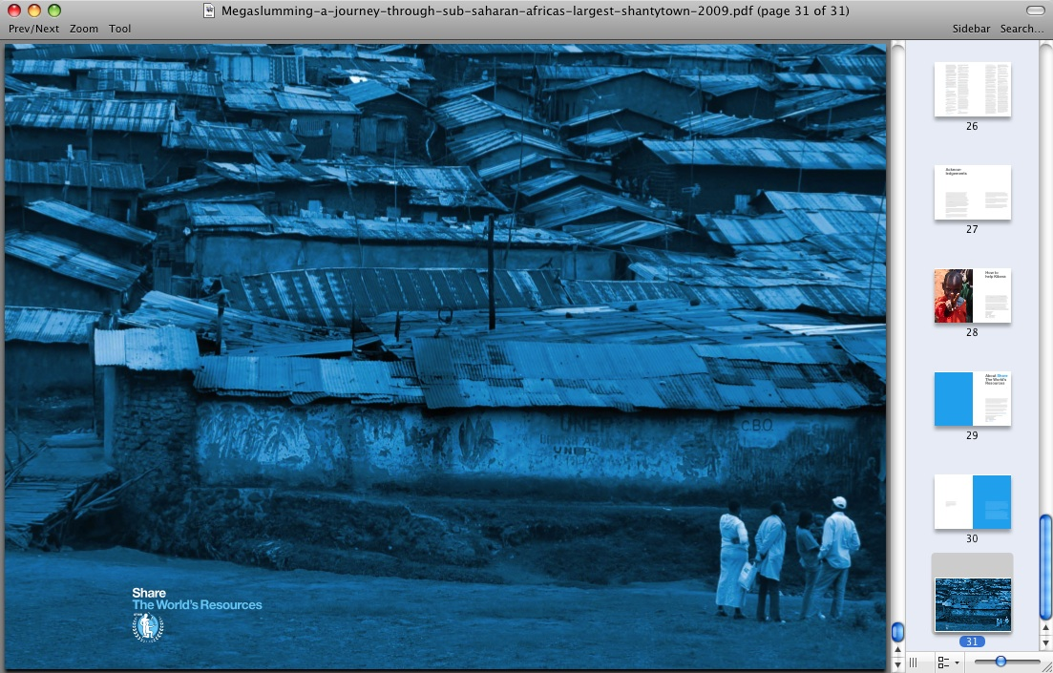
Third World Conurbanizations
Informal Economy
Emergent Middle
Global Economy
Informal Economy
1.3 billion in slums today
2 billion by 2025
All population increase to slums

Slide 4
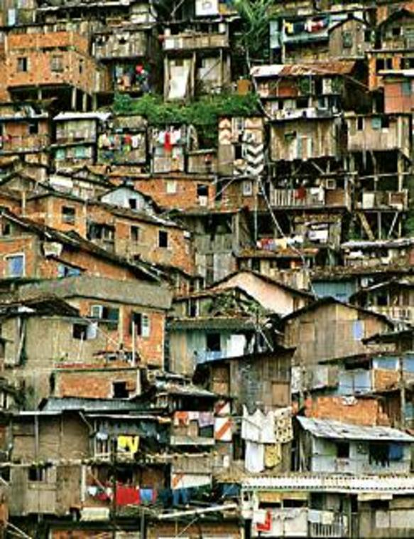
The Twice Dispossessed
1.4 billion people around the globe living in slums, under bridges, on riverbanks, and in garbage dumps.
2 billion urban poor including slaves, homeless, sex trafficking, servants, day laborers, migrants, refugees ...

Slide 5
Civilizations = Mega Cities
Why a MATUL at WCIU? It fits your FV future
Simple-living apostolic orders among the poor,
Civil-izations, Frontiers, People Groups???
Civil – ization = Structured Mega-Cities and surrounding peoples

Slide 6
Wisdom Education: Preparing Grains of Wheat for Movements
If it dies, it produces much fruit
If anyone serves me, he must follow me,
For where I am , my servant will be (John 12:24-26)

Slide 7
Incarnational Education : Preaching a Gospel of Justice begins in being one of the people
HOME
⏎
HOME
⏎

Slide 8
Getting Jesus’ Seminary into the Slums
Jesus
Began in prayer and empowerment
Trained evangelists
In caring for the marginalized
In healing the sick
Storying the scriptures in the midst of poverty
Dealing with realities
Sent them to multiply
MATUL Courses
1. Urban Spirituality
2. Building Faith Communities
3. Solidarity with the Marginalized
4. Community Health Care
5.Biblical Theology of Urban Mission
6. Urban Reality
7. Movement Leadership

Slide 9
Getting Jesus’ Seminary into the Slums
Came declaring the good News of a Jubilee of structural justice
Established an educational process
Formed grains of wheat to make disciples of disciples of disciples of...
Interfaced with the philosophies of Israel
8 Advocacy & Urban Environment
9. Developing Slum Educational Centers
10. Movement Leadership
13 action-reflection research courses, resulting in a final Research project
Etc.

Slide 10
 | Fall Semester 1 In Los Angeles (For those still in the US) | Spring Semester 2 On field | Summer Semester 3 On Field
Year 1 | Urban Spirituality | Social Science Theories of the City
 | Biblical Theology in an Urban Context | Language and Culture Learning 1 | Language and Culture Learning 2
Options | Building Faith Communities | Or Solidarity with the Marginalized | Theology and Praxis of Community Economics
Year 2 | Fall Semester 4 On Field | Spring Semester 5 On Field | Summer Semester 6 On field
 | Leadership in Urban Movements
 | Qualitative Urban Research Methods | Organizational & Entrepreneurial Leadership | Research Project or Thesis
Options | Educational Center Development | Advocacy and the Urban Environment | Community Conflict Transformation
Options | Or Primary Health Care | Community Transformation | Required: Reentry Week in LA

Slide 11
Urban educational processes include:
Entrepreneurial Action
Develop skills from small group formation to navigating international development. One internship extends a theology of justice to stand in the struggle for land rights. Another involves creation of slum schools.
Spiritual & Character Formation
Students learn from church leadership teams among the poor, and community leaders supervise character-build- ing fieldwork. The first course of the program delves into Urban Spirituality.
Theological Reflection & Social Analysis
Movement leadership involves vision, which requires an academic engagement with global literature; an understanding of urban realities and theology; culminating in a research project.

Slide 12
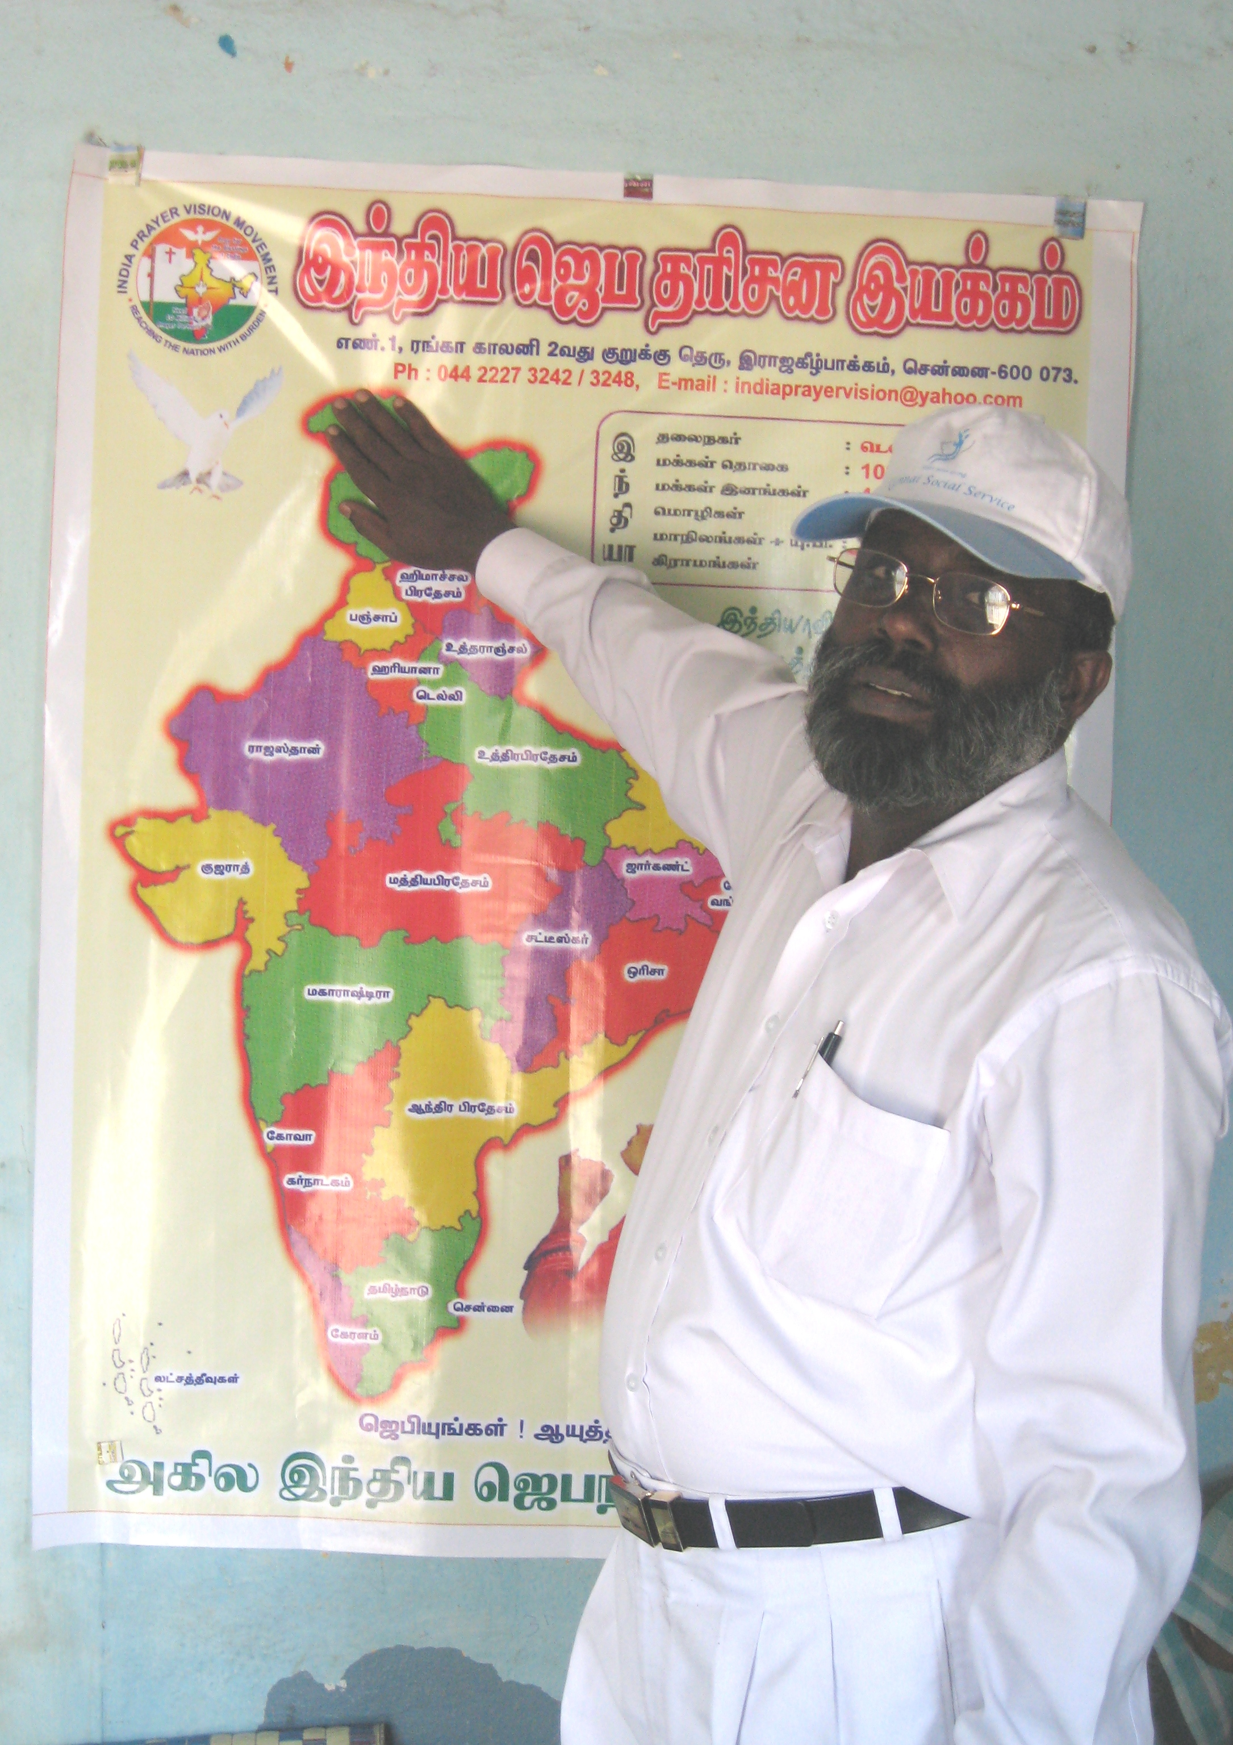
MOVEMENT LEADERSHIP
apostles, prophets, evangelists, pastor-teachers and deacons (= NGO leaders)
Accelerating:
Franciscan preachers and beggars on behalf of the poor
movements of poor people’s churches
economically engaged disciples
activists in the struggles for justice
catalysts in transforming poverty
Pr Elijah, Chennai, from one church of 300 to three churches and 3 schools

Slide 13
Who should join this program?
What kind of career can I get?
Urban Ministry: Those with experience in urban ministry churchplanting and church-based development
Demonstrated Leadership: Those wishing to become change agents among the urban poor cross culturally
Advocacy: Those who may end up in advocacy but need to understand the insides of poverty in order to be effective
Missionary to the Poor
Theologian of the Poor
Entrepreneurial Church Developer
Small Business Entrepreneur
Non-Profit Leader
Philosopher
Professor

Slide 14
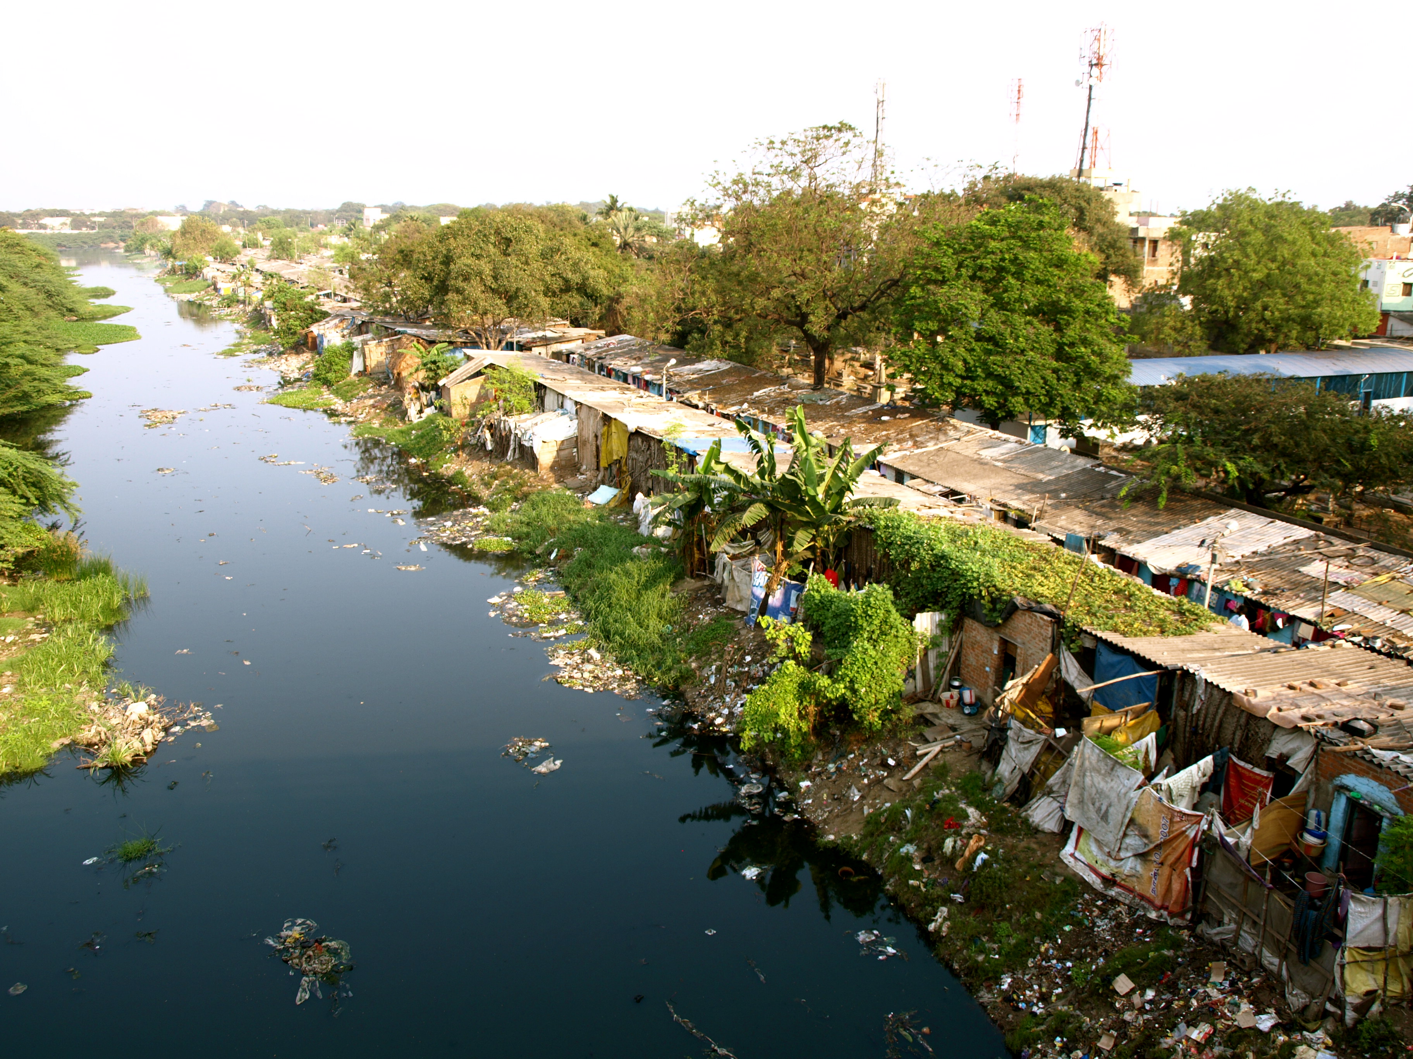
What are the costs for the WCIU MATULdegree?
$450 per unit for Americans
Plus airfares, language school, accommodation
What is the Schedule?
First Classes begin in Sept
Language Study overseas begins in January

Slide 15
Champions Needed: FV are Mobilizers
1. Work with us to find 20 North American students by August:
Graduates (GPA 3.0+)
Wanting to go overseas
Committed to serve the poor for 2 years
Church backing
2. Find 10 overseas emergent slum leaders (2IC’s)

Slide 16
FV are Experts in Movement Leadership?
3. If anyone recruits 10 movement leaders, we can deliver the Movement Leadership course – an online interactive think-tank moving leaders into their next phases.
Do you know all about social movements? They use the same principles, right? And the role of ideas in movements? And revival movements of the Holy Spirit are the same as bible-based movements?

Slide 17
Contact & Info
emily.graham@wciu.edu
View www.matul.org
Look at the first video there.

