Slide 1
MATUL
Master of Arts in Transformational Urban Leadership
A 2-year, entirely field-based program that prepares students to implement spiritual, socioeconomic, political, and environmental change throughout the world.

Slide 2
MATUL
18 graduates
31 students currently placed internationally in 7 countries
16 starting in September
Online 3 times per week
Notes:
Abigail East (Nairobi, Kenya): An Exploratory Study of Familial and Community Involvement of People with Developmental Disabilities Living in Kibera Slum.
Elena Forsythe (Bangkok, Thailand): Storytelling in Bangkok: Biblical Storytelling for Leadership Development in the Slums.
Katie Gard (Manila, Philippines): Bringing the Seminary into the Community: a comparative study exploring partnership opportunities for ATS-CUL/ APU-MATUL with urban poor communities for participatory research in Manila.
Bethel Hamel (Delhi, India): Land Rights in Delhi: A Legal Argument for the Human Rights of Jhuggi Residents.
Ryan Hernandez (Chennai, India): Health Education as Means for Behavioral Change and Subsequent Impact on Healthiness in Women’s Self-help Groups.
Lindsey McDonald (Manila, Philippines): Transforming Lives through Early Childhood Education: A Study of Effectiveness of Mission Ministries Philippines, ECE Program.
Grecia Reyes (Kolkata, India): Exploring the Variation in Health amongst Women Previously Involved in the Sex Trade in Kolkata.
Alissa Wachter (Nairobi, Kenya): Nani atasikia kilio chetu? Who will hear our cries? Girls’ experiences with primary school sanitation facilities in Nairobi’s Mukuru slum.
Brandon Wong (Manila, Philippines): Just Relocation for Isla Puting Bato.

Slide 3
MATUL Student Enrollments
(projected)
Notes:
Dr. Viv Grigg says the original gift to establish MATUL has now impacted at least 22,000 in the slums in small ways, got 17 churches involved in the urban poor, and has been used to leverage additional gifts or pledges of support for the past and present students.

Slide 4
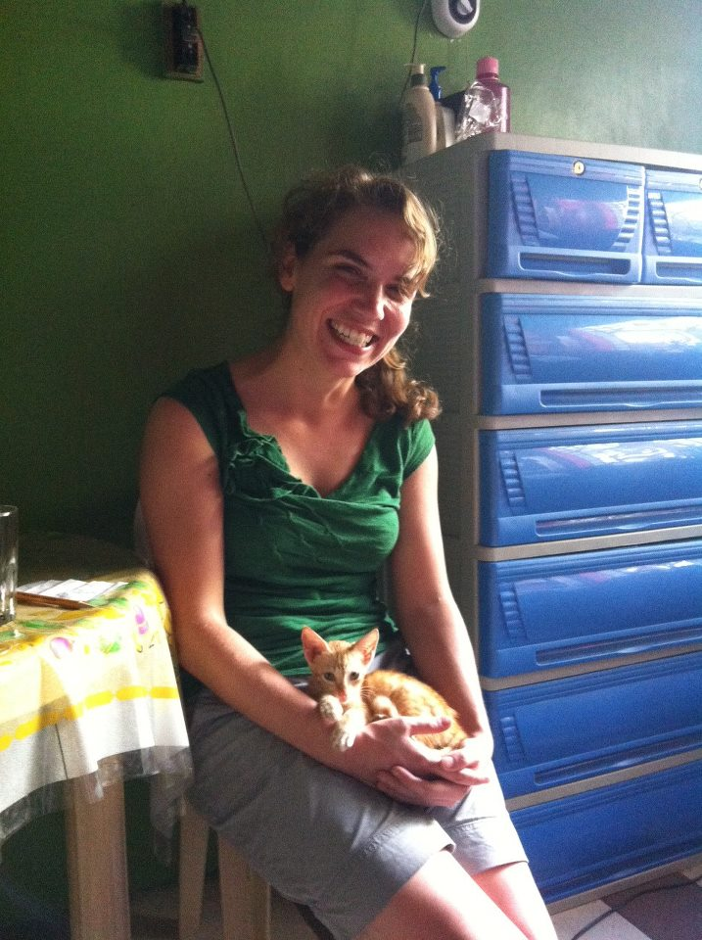
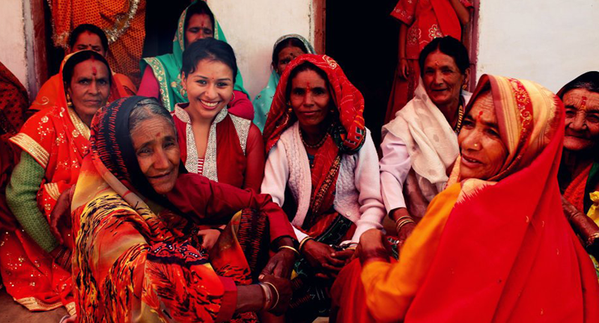
Abigail East (Refugee Resettlement, Kenya)
Grecia Reyes
(Sex-Trafficking , Kolkuta
Alissa Wächter
(NGO Fundraising, Kenya)
Lindsey McDonald
(Church planting, Philippines)
Notes:
Abigail East - MATUL graduate - Working for a non-profit in resettlement of refugees.
Alissa Wächter - MATUL graduate – As a result of her thesis, she is working for One Acre Fund serving small-scale farmers in slums for Kibera.
Grecia Reyes - MATUL graduate – Served in anti-trafficking work with Freesat in India, and now heading to Guatemala for them.
Lindsey McDonald - MATUL graduate - Working with Mission Ministries Philippines in church planting and pioneering the sending of Filipino missionaries into Indian slums.

Slide 5
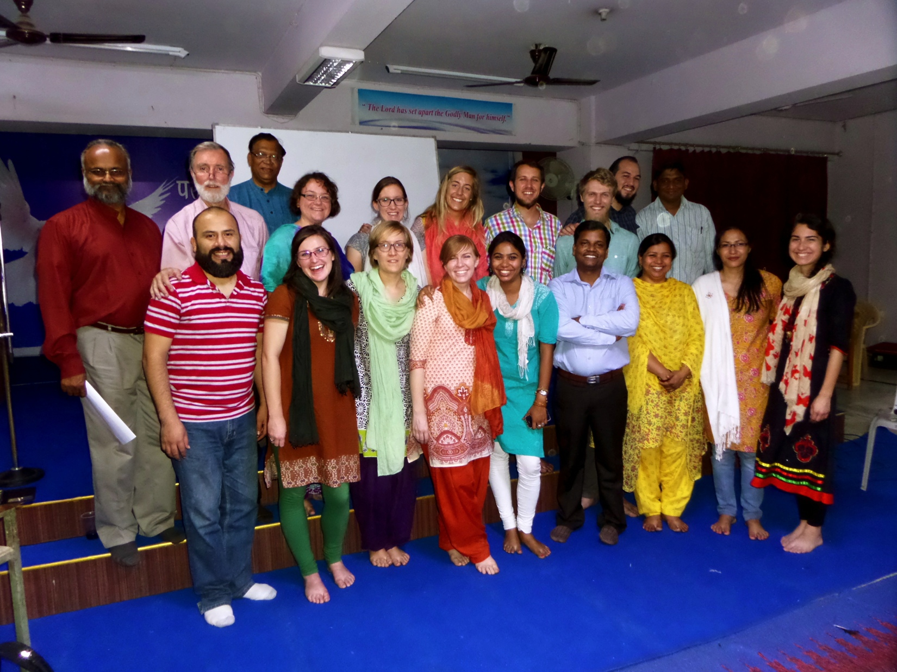
Delhi Training In Community Economics – MATUL Students Giving Leadership

Slide 6
Changes to the Program with move to Azusa Pacific Seminary
Required to add in
Synoptic Gospel
Global Contextual Theologies
Reduce it to 42 units
14 units residency in LA
To do this we had to reduce units for language learning and for the thesis. (Not very ideal)

Slide 7
What do our graduates do?
Raising scholarships
MOU’s with partner schools
The issue of Liability insurance.

Slide 8
Notes:
Matt Browning: “I had the image in my head of living at the corner of the Great Command and the Great Commission. The Great Command says love your neighbor and the Great Commission says make sure everyone, your neighbor or not, gets to hear the story of Jesus.
If we live at the corner of the Great Command and the Great Commission we can't help but live the message of Jesus that says everyone matters.
If APU is a city on a hill, perhaps main street in that city is at the corner of the Great Command and Great Commission.

