Slide 1

A Theology of
Economic Discipleship:
10 Principles
Viv Grigg
Delhi Consultation 2015

Slide 2
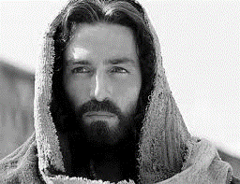
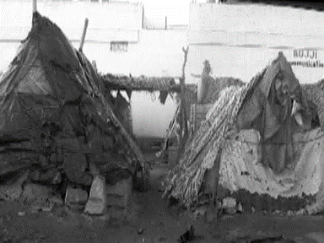
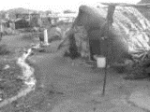
A Theology of Economic Discipleship
Jesus came “to preach good news of the Kingdom of God to the poor, to set the captives free, to declare the acceptable year of the Lord” Luke 4:18-19.
When the people heard him, what did they understand?

Slide 3

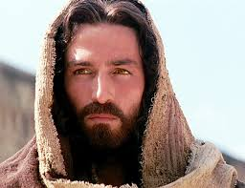
LOVE & Human Worth
1st Principle
“So God created people in his own image; God patterned them after himself…” Gen 1:27
1st act of Love was creation.
Human Dignity: “So God created people in his own image; God patterned them after himself…” Gen 1:27
Economic Discipleship is The redemption of the dignity of individuals in their material relationships within communities.

Slide 4
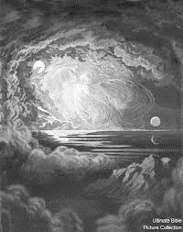

Creativity
God the creator.
2nd Principle
“In the beginning God created…” Gen 1:1
God is the creative worker
  His work was good, expressing beauty
  Made something out of nothing
  Evolved each step into something new – incremental business
  His work was artistic

Slide 5

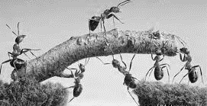
Productivity
3rd Principle
His work was good
  Work is honourable
  God’s work can be seen in four categories:
    Creation – making new things
    Providence – providing for families and communities
    Judgement – Structuring life, organizations, cities….
    Redemption – righiting that which is broken…

Slide 6
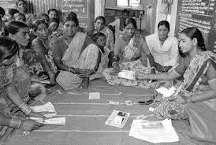

Cooperation
“Let us” Make… (Gen.1:26)
4th Principle
God is an “usness”
Let “us” make
The history of Economic Theology highlights this theme.
  Different to Marxism
  Different to Capitalism
  e.g Liberty Trust in New Zealand
  e.g self-help groups
  e.g. micorfinance loan groups

Slide 7
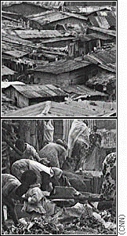
Work & Rest:
“On the 7th day he rested”…(Gen.2:1)
5th Principle
Human work
  To manage the earth
  To subdue it
  To fill it
Work was cursed in the fall
  It became hard work
    From gardener to farmer, from fulfilment to frustration
  But the command to manage did not change
Abuse of work takes two forms:
  Idleness
  Overwork
Work without rest is one of the major sins

Slide 8
A Theology of Economic Discipleship:
Levels of Application
1.Love and Human Worth,
2. Creativity
3. Productivity
4. Co-operation
5. Work & Rest
International
Community
Micro Finance
Cooperative Economics
Self Help Groups
Self
Family
National

Slide 9
Ten Principles of Economic Discipleship: Love is expressed in the following ways
Principle | Genesis 1-4 | Sabbath & Jubilee (Lev 23,25) | Gospels & Acts | Epistles
1. Love and Human Worth | Created in God’s Image |  | Care for the lame, blind, needy, widows | Core for widows, orphans
2. Creativity | God the Creator |  |  | Spirit sets free
3. Productivity | Good Outcomes | 6yr and 49yrs of productivity | Parables of multiplying seed as a Kingdom Principle.
4. Cooperation | Let “us” make |  | Common purse, Not a needy one among them. | Provide for others
5. Work & Rest | He Makes He Structures God Rests, Sabbath Rest, Jubilee Rest | He provides supernaturally | Labor in the gospel, yet he will provide food and clothing. Jubilee come | Work with hands (1 Thes 4:11), provide for family and for needy

Slide 10
Ten Principles of Economic Discipleship: Love is expressed in the following ways
Principle | Genesis 1-4 | Sabbath & Jubilee (Lev 23,25) | Gospels & Acts | Epistles
1. Love (and Human Worth)
2. Creativity
3. Productivity
4. Cooperation
5. Work & Rest
6. Simplicity
7. Redistribution
8. Management
9. Ownership
10. Celebration

Slide 11
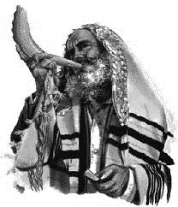
Redistribution
Year of Jubilee!! Lev 25:8-17
6th Principle
Every 50th year,
It was a time of equalizing.
I. LIBERTY
It is synonymous with the year of liberty.
Slaves are to be set free.
II. DEBTS ARE TO BE CANCELED.
Economic freedom is inherent in the gospel message

Slide 12
Redistribution
Year of Jubilee!! Lev 25:8-17
6th Principle
III. CELEBRATION.
Celebration is inherent in
the gospel message.
IV. REDISTRIBUTION
The means of production, the land was to be returned to the original owners. Redistribution of the means of production is inherent in the gospel message.
V. OWNERSHIP
Even the Levites were to have their own home

Slide 13
Redistribution
Jubilee Economics in the ACTS Community
ACTS 2:42-44
6th Principle
This theme of the Jubilee becomes central to the New Testament
  In the central passage around which Luke builds his gospel and the Acts, Luke 4:18, Jesus declares his mission of Jubilee
  He inaugurates the Jubilee eternally.

Slide 14
Redistribution
Jubilee Economics in the ACTS Community
ACTS 2:42-44
6th Principle
Rich 5%
Middle Class 10%
A RANGE OF JUSTICE & EQUALITY
Labouring Poor 45%
Destitute Poor 40%

Slide 15
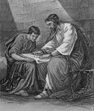
Simplicity detachment
7th Principle
Sell your possessions and give to the poor, and come follow me.
Unless a man… forsakes all that he has, he cannot be my disciple (Luke 14:33)
But seek first his Kingdom and his righteousness and all these things will be yours as well (Matt 6:33).
Earn Much,
Consume Little,
Hoard Nothing,
Give Generously,
Celebrate Life
Viv Grigg, 1984

Slide 16
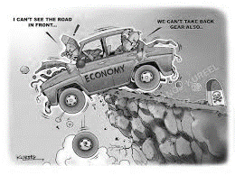


Management savings and debt
8th Principle
Manage the Earth
Jubilee cancels debts
Land needs rest
Parables of Stewardship, Debts cancelled
Role of a Deacon
Give 10%, Save 10%
Owe no person
“Earn Much, Consume Little, Hoard Nothing, Give Generously, Celebrate Life” Viv Grigg

Slide 17
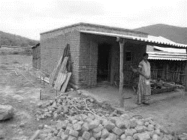
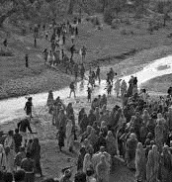
  Ownership
  Even the Levites were to have their own home.
9th Principle
“…each of you returns to the lands that belonged to your ancestors and rejoins your clan.” (Lev. 25: 10)
Provide for your family (food and shelter) “ Anyone who does not provide for their relatives, and especially for their own household, has denied the faith and is worse than an unbeliever.” (1Tim.5:8)
Each family to own their own Home (including Levites)
Each family to be given back land
All to own a home
Forsake all, yet own home
Provide for Family (1 Tim 5:8)

Slide 18

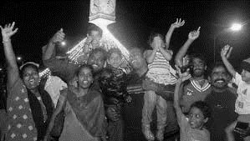
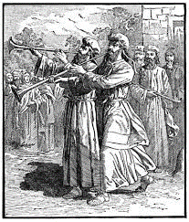
Celebration worship and give thanks.
10th Principle
Sharing leads to rejoicing
Rejoicing leads to celebration
“Earn Much, Consume Little, Hoard Nothing, Give Generously, Celebrate Life” Viv Grigg

Slide 19
Ten Principles of Economic Discipleship: Love is expressed in the following ways
Principle | Genesis 1-4 | Sabbath & Jubilee (Lev 23,25) | Gospels & Acts | Epistles
1. Love and Human Worth | Created in God’s Image |  | Care for the lame, blind, needy, widows | Core for widows, orphans
2. Creativity | God the Creator |  |  | Spirit sets free
3. Productivity | Good Outcomes | 6yr and 49yrs of productivity | Parables of multiplying seed as a Kingdom Principle.
4. Cooperation | Let “us” make |  | Common purse, Not a needy one among them. | Provide for others
5. Work & Rest | He Makes He Structures God Rests, Sabbath Rest, Jubilee Rest | He provides supernaturally | Labor in the gospel, yet he will provide food and clothing. Jubilee come | Work with hands (1 Thes 4:11), provide for family and for needy

Slide 20
Ten Principles of Economic Discipleship Love is expressed in the following ways
Principle | Genesis 1-4 | Sabbath & Jubilee (Lev 23,25) | Gospels & Acts | Epistles
6. Simplicity
7. Redistribution | Abraham tithes | Jubilee –return of land | No needy one Weekly Giving | Global redistribution (2 Cor. 8,9)
8. Management | Manage the Earth, Jubilee cancels debts | Land needs rest | Parables of Stewardship, Debts cancelled | Role of a Deacon Owe no person, Simplicity
9. Celebration | Each family to own their own Home (including Levites) | Each family to be given back land All to own. | Forsake all, yet own home. | Provide for Family (1 Tim 5:8)
10. Celebration | It was good | Blow Trumpet | Worship Daily

Slide 21
Small Group Discussion
Love and Human Dignity
Passages:
  Psalm 139:13-16
  John 1:12
  Romans 8:15
Questions:
  How much are you worth?
  Why?
  How do you show others who valuable they are? How do you help children know they are valuable.

Slide 22
Discussion 2
Creativity
  What is creativity?
  How have you helped others to be creative?
Productivity
  Passages: Eph 2:10; John 16:15
  What do you produce? Is it good? Is it very good? Does it multiply?
  How have you helped others to be productive?

