Slide 1
Development Economics
Viv Grigg

Slide 2
Its Focus?
Development economics focuses on how nations can evolve out of poverty.
It tends to have both financial, liberational and social goals as outcomes, much more than classical economics.

Slide 3
APPLYING 10 Principles of Economic Discipleship TO NATIONAL DEVELOPMENT
1.Love and Human Worth,
2. Creativity
3. Productivity
4. Co-operation
5. Work & Rest
6. Simplicity
7. Redistribution
8. Management
9. Ownership
10. Celebration & FReedom

Slide 4
10,000 YEARS of Ideal Societies – and Future THEOLOGICAL Ideal
Idealized Description | Band | Tribal | Peasant | Urban/Modern | Postmodern Megacity
Economic Production | Mobile | Slash and Burn | Settled Agriculture | Manufacturing + Agriculture | High Tech + Manufacturing + Agriculture
Leadership & Decision-making | Familial | Clans and Chiefs | Feudal Lord and Peasant | Councils, elections | Big Man, diverse
Technology | Stone age | Bronze, iron utensils | Farming utensils, blacksmith | City systems, auto, manufactured goods | Electronic, biological, internet
Religion | Spirit worship | Spirit, totemic | Folk Religion within Larger traditions | Multiple traditions, disjoint, secularising | Multi-dimensioned Cross overs, secular
Cultures | Extended Family | Multiple tribes | Singlular culture | Clustered multiculture | Networked
Reign of God
Eternal Energy
Justice around King, delegated
Inter-galactic
Worship of King
Multicultural

Slide 5
Development to what? CURRENT Alternative Visions of the Future
Cultural Dimension | Marx & Engels | Global Socialism | Democratic Capitalism | Kingdom of God
Economics | Proletariat control means of production | Gradual expansion of governmental control of production | Capitalists control means of production | Cooperative ownership of means of production
Leadership | Marx: Proletariat Engels in reality: Dictatorship | In reality: Bureaucracy of the proletariat | Rulership by Capitalists in partnership with elected. Works best in a democratic state | Just King, delegated authority to servant leaders
Religion | Anti-Christian, anti-religious | Secular | Christian base/ increasing secularization | Christ as Centre

Slide 6
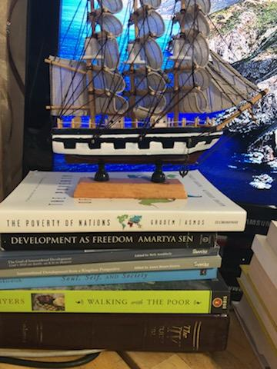
HISTORY of development economics
Mercantilism: 17th, 18th Century: a nation's prosperity depends on its supply of capital from maximized exports and minimized imports. hence significant protective tariffs and subsidies are employed. This was largely dependent on importation of Bullion from colonies (von Hornick, Colbert).

Slide 7
MAJOR THEORIES OF DEVELOPMENT ECONOMICS
(Nation-Building)
1 Mercantil-ism
2 Civilizing Nations
Economic nationalism
3 Post-WWII theories .
Every Era/ Decade produces new theories
How do you contrast these with theological paradigms of the same periods ( see Grigg, Transformative Revival, ch 2.)
Each discipline develops its set of theories
4 Linear-stages-of-growth model (Rostow)
5 Structural change theories
6 Internat’l dependency theory
Solution Synthesis
9 Neoclassical theory
.
7 Dualism
8 Marginality
Deconstructive Analysis

Slide 8
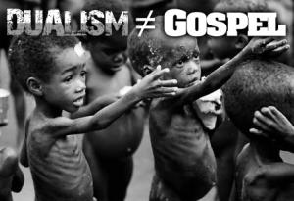
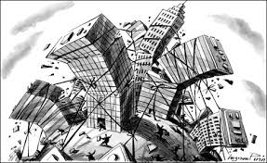
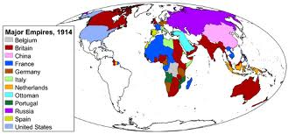
TIMELINE
Mercantilism
National Development
Linear Takeoff
Neoliberalism
14-18th C
15th-1920
1944-1985
1970’s-90’s
Late 1980’s
1989 on
Civilizing Empires
Dualism
Marginality
Global Capitalism

Slide 9
I. LINEAR STAGES THEORY
BIBLICAL PRINCIPLES
SAVINGS LEADS TO PRODUCTION

Slide 10
I. LINEAR STAGES THEORY
DEVELOPMENT AS GROWTH
Post-war interest on newly independent nations
Economists had no conceptual apparatus for largely agrarian countries w/o modern economic structures
Notes:
Marshall Plan: Sec. of State George Marshall | in order to prevent the spread of Soviet Communism.^{[1]} The plan was in operation for four years beginning in April 1948.^{[2]} The goals of the United States were to rebuild a war-devastated region, remove trade barriers, modernize industry, and make Europe prosperous again.^{[3]} The term "equivalent of the Marshall Plan" is often used to describe a proposed large-scale rescue program.

Slide 11
Linear Takeoff theory
W.W. Rostow,an American economist who presented 'Stages of Growth' model of development.
(1) Traditional society,
(2) Pre-conditions to take-off,
(3) Take-off,
(4) Drive to maturity,
(5) High mass consumption.
Read an analysis of Rostows's Theory here: http://economicsconcepts.com/linear_stages_theory_and_rostow%27s_stages_of_economic_growth.htm

Slide 12
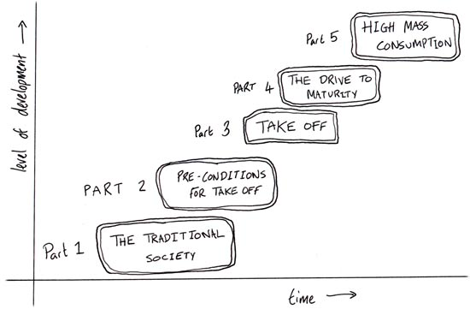
I. LINEAR STAGES THEORY
Rostow’s Stages of Growth
* Developed countries already passed all stages. Underdeveloped in traditional and preconditions stage should just follow rules of dev’t to self-sustaining economy
Notes:
American economic historian Walt W. Rostow. One of the principal strategies of development necessary for any takeoff
was the mobilization of domestic and foreign saving in order to generate sufficient investment to accelerate economic growth

Slide 13
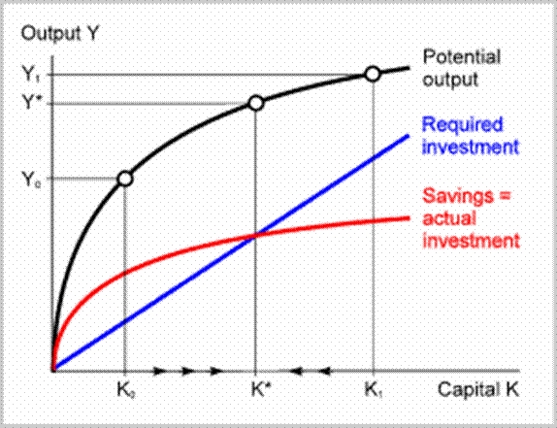
LINEAR STAGES THEORY
The Harrod-Domar Growth Model
the rate of growth of GDP ( Y/Y) is determined jointly by the net national savings ratio, s, and the national capital-output ratio, c.
* To grow, economies must save and invest
* Other components: labor force growth & technological progress
Sample:
Countries able to save 15% to 20% would develop faster
PROBLEM: relatively low level of new capital formation in most poor countries
ANSWER: through either foreign aid or private foreign investment (justified Marshall plan for developing world)
Notes:
Sir Roy Harrod & Evsey Domar, who developed it in 1939 and 1946, respectively. See http://prezi.com/r6qh5t9xracf/harrod-domar-growth-model/
Capital output ratio: if $3 of capital is always necessary to produce an annual $1 stream of GDP

Slide 14
LINEAR STAGES THEORY
PROBLEMS
Mechanisms of development embodied in the theory DO NOT ALWAYS WORK
WHY? More savings and investment are not sufficient
Worked for Europe because of necessary structural, institutional, and attitudinal conditions

Slide 15
II. STRUCTURAL CHANGE
BIBLICAL PRINCIPLES
MANAGEMENT

Slide 16
II. STRUCTURAL CHANGE
PATTERNS OF DEVELOPMENT ANALYSIS
Economic, industrial and institutional structure of an economy transformed to permit new industries as engine of growth
Capital accumulation + changes in economic structure needed
Constraints (affect level of dev’t): Internal - resources, population size, government policies; External – access to capital, technology, trade (countries as part of internatl system)
Empirical work of Harvard economist Holllis Chenery and his colleagues, cross-sectional and time-series studies of countries at diff. levels of per capital income, identified characteristic features of the development process:
Notes:
Not just increased savings and investment. Based on empirical work of Harvard economist Hollis Chenery and colleagues.

Slide 17
II. STRUCTURAL CHANGE
PATTERNS OF DEVELOPMENT ANALYSIS
Shift from agri to industrial production
Steady accumulation of physical and human capital
Change in consumer demand from basic necessities to diverse manufactured goods
Growth of cities and urban industries
Decline in family size and overall population growth
- Proponents of structural change model prefer “facts to speak for themselves” unlike theories such as stages of growth
Notes:
Not just increased savings and investment. Based on empirical work of Harvard economist Hollis Chenery and colleagues.

Slide 18
II. DEPENDENCY THEORIES
BIBLICAL PRINCIPLES
AGAINST USURY, KEEP OUT OF DEBT
LIBERTY FROM OPPRESSION

Slide 19
III. The Opposite View: Dependency Theory
1970’s Developing countries caught in a dependence and dominance relationship with rich countries because of institutional, political and economic rigidities, which have an interest in maintaining their dominant position => difficulty for poor nations to be self-reliant and independent
International dependency theory, neocolonial dependence theory, has its origins in Marxism and views the failure of many developing nations to undergo successful development as being the result of the historical development of the international capitalist system.
Resurgence in various forms in the 21st century

Slide 20
III. INTERNATIONAL-DEPENDENCE
1. NEOCOLONIAL DEPENDENCY – ROLE OF ELITES
Small elite ruling class (landlords, entreps, military rulers, merchants, public officials, etc.) interests (knowingly or not) to perpetuate the international capitalist system of inequality
The elite serve or are rewarded by international special-interest power groups tied by allegiance or funding to wealthy capitalist countries
Elites’ viewpoints inhibit genuine reform efforts and may lead to even lower levels of living and perpetuation of underdevelopment
External-induced against internal constraints

Slide 21
IIIB. INTERNATIONAL-DEPENDENCE REVOLUTION
2. REVOLUTION
Revolutionary struggles or major restructuring of world capitalist system required to free dependent nations
Notes:
. . Dependence is a conditioning situation in which the economies of one group of countries are conditioned by the development
and expansion of others. A relationship of interdependence between two or more economies or between such economies and the world trading system becomes a dependent relationship when some countries can expand through selfimpulsion while others, being in a dependent position, can only expand as a reflection of the expansion of the dominant countries, which may have positive or negative effects on their immediate development. In either case, the basic situation of dependence causes these countries to be both backward and exploited. Dominant
countries are endowed with technological, commercial, capital and sociopolitical predominance over dependent countries—the form of this predominance varying according to the particular historical moment—and can therefore exploit them, and extract part of the locally produced surplus. Dependence, then, is based upon an international division of labor which allows industrial development to take place in some countries while restricting it in others, whose growth is conditioned by and subjected to the power centers of the world.

Slide 22
IIIB. INTERNATIONAL-DEPENDENCE
3. EXPANDED THEORY
Theotonio Dos Santos
Dependence as conditioning situation ;
Expand based on expansion of dominant countries; Dominant countries w/ technological, commercial, capital and sociopolitical predominance can exploit and extract local surplus;
Dependence as based on the international division of labor – industrial development in some and restricted in others
Notes:
. . Dependence is a conditioning situation in which the economies of one group of countries are conditioned by the development
and expansion of others. A relationship of interdependence between two or more economies or between such economies and the world trading system becomes a dependent relationship when some countries can expand through selfimpulsion while others, being in a dependent position, can only expand as a reflection of the expansion of the dominant countries, which may have positive or negative effects on their immediate development. In either case, the basic situation of dependence causes these countries to be both backward and exploited. Dominant
countries are endowed with technological, commercial, capital and sociopolitical predominance over dependent countries—the form of this predominance varying according to the particular historical moment—and can therefore exploit them, and extract part of the locally produced surplus. Dependence, then, is based upon an international division of labor which allows industrial development to take place in some countries while restricting it in others, whose growth is conditioned by and subjected to the power centers of the world.

Slide 23
IIIB. INTERNATIONAL-DEPENDENCE
4. CATHOLIC TEACHING
Pope John Paul II: One must denounce the existence of economic, financial, and social mechanisms which, although they are manipulated by people, often function almost automatically, thus accentuating the situation of wealth for some and poverty for the rest. These mechanisms, which are maneuvered directly or indirectly by the more developed countries, by their very functioning, favor the interests of the people manipulating them. But in the end. they suffocate or condition the economies of the less developed countries.

Slide 24
III. INTERNATIONAL-DEPENDENCE
5. FALSE-PARADIGM MODEL
less-radical
Underdevelopment as result of faulty and inappropriate advice by well-meaning, though uninformed or biased advisers from developed country agencies and orgs
Inappropriate policies merely serving vested interests of existing power groups (domestic and international)
Intellectuals, economists, civil servants trained in alien and “irrelevant” Western concepts
Notes:
remarkably resilient role of traditional social structures (tribe, caste, class, etc.), the highly unequal ownership of land and other property rights, the disproportionate control by local elites over domestic and international financial assets, and the very unequal access to credit, these policies, based as they often are on mainstream, neoclassical (or perhaps Lewis-type surplus-labor or Chenery-type structural-change) models, in many cases merely serve the vested interests of existing power groups, both domestic and international.

Slide 25
IV. ECONOMIC DUALISM

Slide 26
IV. Economic Dualism
The coexistence of modern and traditional sectors within an economy, especially as found in less-developed countries.
It is the international-structuralist model which highlighted the concept of dual societies. This means that there exist rich nations and poor nations at world level; and a few rich accompanied with a majority of poor people in the developing countries. Thus, dualism is a concept which represents the existence and persistence of increasing divergences between rich and poor both at world level and at country levels.

Slide 27
Economic Dualism
International Dualism:
There are four components of international dualism:
(i) There exist greater differences in between different countries and geographical regions regarding per capita incomes.
(ii) These differences are not temporary and short termed, rather they are chronic. As the standard of living enjoyed by an average Pakistani and that of an American is different for centuries, not for decades.
(iii) These differences go on increasing, rather decreasing. As the growth rates of GNP and that of GNP per capita have really been widened between developed countries and under-developed countries.
(iv) The inter-relationships between rich and poor countries in international economy are of such a nature that they have promoted the growth of the rich countries at the cost of poor countries.

Slide 28
Factors in Economic Dualism
The following factors have been found responsible for international dualism:
(i) The DCs have a power to control and manipulate world resources and commodity markets to their advantage.
(ii) The foreign investment activities by MNCs.
(iii) The privileged access of rich nations to scarce raw material.
(iv) The export of unsuitable and inappropriate science and technology.
(v) The transfer of out-dated and irrelevant systems of education to societies where education is considered as a key component in the process of development.

Slide 29
Factors in Economic Dualism
(vi) Dumping policies pursued by the rich countries which discourage industrialization efforts of UDCs.
(vii) The harmful international trade theories and policies which have confined the UDCs to export just primary products.
(viii) The harmful aid policies pursued by donors which help in perpetuating the international dualistic economic structures.
(ix) The creation of elites in poor countries who are influenced by the external ideas.
(x) The transfer of unsuitable methods of university training for unrealistic and often irrelevant international professional standards, for instance the externally conceived degree requirements for doctors, engineers, technicians and economists.

Slide 30
Factors in Economic Dualism
(xi) The international brain-drain which has encouraged the international mobility to the rich nations because of handsome salaries etc.
(xii) The demoralizing 'Demonstration Effect' of luxury consumption on the part of wealthy people both at home and abroad, as propagated in through foreign movies and magazine advertisements.
No doubt, most of the problems arising out of international poverty are due to international capitalistic system, yet the poverty of UDCs can not be entirely attributed to the behavior of rich countries. Thus we conclude international dualism with the remarks given by Hans Singer:
"The growth in the rich countries has led to develop the most sophisticated, costly and capital intensive technologies, mortality reducing and diseases control measures etc. All such have led to create population explosion, rising unemployment and inability to develop their own technological capacities".

Slide 31
Domestic/Local Dualism
Above we told of international dualism where we showed that greater differences exist regarding social and economic aspects between the rich countries and poor countries. The same like situation also exists in case of poor countries at the domestic levels. It is shown by the following arguments:
(i) The standards of living vary greatly between the top 20% and the bottom 40% of the population. The majority of the rich reside in big cities like Lahore, Karachi and Islamabad in Pakistan, while the great cluster of mass poverty are generally found in the rural regions.
Not to talk of disparities in life standard of the rich and the poor of the UDCs, there also exist the pockets of great wealth co-existing with spreading slums. The case of exalted buildings and increasing Katchi Abadies (Muddy Shelters) in Karachi is before us. The phenomenon of inferior and superior not only exists in respect of distribution of wealth, income and power, it is also available in the technological nature of UDCs industrial production. The advanced manufactured large sector using capital intensive technologies co exists with labor intensive, small scale activities catering for limited local needs.

Slide 32
DOMESTIC Dualism (cont).
(ii) The coexistences of a few rich accompanied by mass poverty, and the craze to use capital intensive technologies by a few producers accompanied by labor intensive technologies by majority of the producers go on increasing, rather disappearing.
(iii) The gap between the rich and the poor, and between modern and traditional methods of production shows signs of growing even wider, not only within individual UDCs, but also among the 3rd world countries as a group. Countries like South Korea, Singapore, Taiwan and Malaysia etc. have experienced higher growth rates of per capita. While Pakistan India, Bangladesh and Ghana etc., have shown a little growth in per capita income. Again, the gap between the rich and the poor within the dualistic economies is also widening.
(iv) In case of UDCs one does not find any relationship between the rising wealth of modern enclaves and improvement in the living standards of traditional society. In other words, in case of dual societies one does not find the existence of "Spread Effects". It means that the growth of the superior is keeping inferior more weaker and inferior.

Slide 33
V. NEOCLASSICAL
COUNTER-REVOLUTION

Slide 34
V. NEOCLASSICAL COUNTERREVOLUTION
Context
Emerged in the 1980s during political ascendancy of conservative governments of US, Canada, Britain and West Germany
Neoclassicists on the board of powerful international agencies World Bank and International Monetary Fund as influence of International Labor Organization, United Nations Development Program and United Nations Conference on Trade and Development eroded

Slide 35
Neoclassical theory (Neo-liberalism)
Neoclassical theories argue that governments should not intervene in the economy; in other words, these theories are claiming that an unobstructed free market is the best means of inducing rapid and successful development.
Competitive free markets unrestrained by excessive government regulation are seen as being able to naturally ensure that the allocation of resources occurs with the greatest efficiency possible and the economic growth is raised and stabilized.
The market-friendly approach, unlike the other two, is a more recent development and is often associated with the World Bank. This approach still advocates free markets but recognizes that there are many imperfections in the markets of many developing nations and thus argues that some government intervention is an effective means of fixing such imperfections

Slide 36
V. NEOCLASSICAL COUNTERREVOLUTION
Argument
Underdevelopment resulted from poor resource allocation because of incorrect pricing policies and state intervention (corruption, inefficiency, lack of incentives, etc.)
State intervention slows economic growth
Neoliberals: economic efficiency and growth will be stimulated by free markets, privatizing state enterprises, export expansion and eliminating government regulation and price distortions
Allow “magic of the marketplace” and “invisible hand” to guide resource allocation and stimulate economic dev’t.
Notes:
point both to the success of economies like South Korea, Taiwan, and Singapore as “free market” examples (although, as we shall see later, these Asian Tigers are far from the laissez-faire neoconservative prototype) and to the failures of the public-interventionist economies of Africa and Latin America.

Slide 37
V. NEOCLASSICAL COUNTERREVOLUTION
3 component approaches
Free-market approach - markets alone are efficient; competition is effective, technology and information freely available and costless; gov’t is counterproductive
Public choice approach - new political economy approach; governments do nothing right because of selfish interests; misallocation of resources
Market-friendly approach – imperfections in economy and need gov’t for market-friendly interventions (social services and climate for private enterprise); acceptance of market failures.
Notes:
2. Resources to maintain power, bribery for rent-seeking citizens and protected businesses, confiscate private property

Slide 38
V. NEOCLASSICAL COUNTERREVOLUTION
Traditional Neoclassical Growth Theory
Liberalization – opening up of markets, draw investment and increase rate of capital accumulation
Solow neoclassical growth model - economies to converge to same income level if same rates of savings, depreciation, labor force and productivity growth.
Source of output growth: labor quantity and quality, increase in capital and technology improvement
Openness – encourages access to foreign production ideas, technological progress
Notes:
Nobel prize winner Robert Solow.

Slide 39
V. NEOCLASSICAL COUNTERREVOLUTION
CONCLUSIONS
Finger-pointing between dependence theorists (many from developing countries, seeing underdevelopment as externally induced phenomenon) and neoclassical revisionists (most from Western economies, blame gov’t intervention and bad economic policies)
Market price allocation may do a better job than state intervention but developing economies have very different structures:
Competitive free markets generally do not exist, information is limited, markets fragmented, etc.

Slide 40
V. NEOCLASSICAL COUNTERREVOLUTION
CONCLUSIONS
Invisible hand often lifts those already well-off, failing to offer opportunities for upward mobility of the majority
Lessons from supply-and-demand analysis to arrive at “correct” prices
“In an environment of widespread institutional rigidity and severe socioeconomic inequality, both markets and governments will typically fail.”

Slide 41
VI. The Sustainability Debate
Largely beginning with Schumacher’s Small is Beautiful, a realization that the earth’s resources are finite. Define the issues in the debate.
Define the concept of triple bottom line
Profit and loss
??
??
Sustainability for grassroots organizations
Survival
Indigenous funding generation
The local church is the sustainable movement for most NGO’s that feed of its resource generation.

Slide 42
Kingdom Economics and Sustainability
Our aim is not economic development
Our aim is not transforming poverty
Our aim is not participatory community development.
These are subsidiary goals of expanding movements of the Kingdom of God.
We develop communities of the Kingdom within communities (usually churches)
We develop movements of these communities (usually denominations)
At every step these bring about transformation of lives, families communities in small sustainable ways

Slide 43
VII. CULTURAL THEORIES
ECONOMIC DISCIPLESHIP PRINCIPLE 1: WORTH & DIGNTIY OF INDIVIDUAL, #2 CREATIVITY, #10: LIBERTY

Slide 44
RELIGIOUS & CULTURAL VALUES LEAD TO ENTREPRENEURSHIP
MAX WEBER- The Spirit of Caplitalism
In this he identifies religious belief systems and their production of qualities that enable good entreprenurs (thugh that word was not invented)
HAGEN, Psychological aspects of entreprenruship
MCLELLAND. N-ACHEIVEMENT ( term used prior to entrepreneurship). He did over a hundred gobal studies on saspects of producing and entreprneurisal society.

Slide 45
DEVELOPMENT AS FREEDOM
(SEN)
Reframed the Goals of Development around Freedom (not ulike jesus and his declaration of Jubilee)
“Development is a process of expanding the real freedoms that people enjoy”
Freedom depends on determinants
Requires removal of barriers

Slide 46
Determinants of Freedom
Social and Economic arrangements
Facilities for health
Educational structure
Political and civil rights
Technological progress

Slide 47
Removing Obstacles to Freedom
Tyranny
Por economic opportunities
Systematic social deprivation
Neglect of public facilities
Intolerance or overactivity of repressive states

Slide 48
References
Vandana Desai and Robert Potter. (2008). The Companion to Development Studies, 2nd edn. Hodder Education. Useful Summary of Theories.
Rostow, W.W. (1991).The Stages of Economic Growth: A Non-Communist Manifesto (3rd ed.). Cambridge: Cambridge University Press.
UNHabitat. (2009) Planning Sustainable Cities. Global Report on Human Settlements 2009. London: Earthscan.

