Slide 1
Microenterprise Development as part of extending the Kingdom of God
Viv Grigg
MA in Transformational Urban Leadership
TUL560 Community Economics

Slide 2
Poor People Save
Poor people save and have been doing so in the 2/3 world for centuries, relying on informal mechanisms to save.
Informal Finance- all financial transactions, loans and deposits, occurring outside the regulation of a central monetary or financial market authority.

Slide 3
Christian Microfinance ch 3
Income Generating Activities
Micro-enterprise (1-10 empoyees)
Small Enterprise
(11-50)
Medium Scale Enterprise (51 or more)
Large Scale Enterprise
Group based
Sidewalks
Lowest 15%
Vulnerable
Unlikely to grow
Increased income
Employment

Slide 4
The Poor Will Be Glad
Chapter 7: Microfinance Goes Mainstream
This section by Alissa Wachter

Slide 5
Microfinance Goes Mainstream
“Providing financial services, such as small loans,
to poor people so they can increase their income
and decrease their vulnerability to
unforeseen circumstances.
Muhammad Yunus wins Nobel Peace Prize in 2006
Most poor people in developing countries are “clinging to the edge of a cliff”
Small loans permanently improve conditions by allowing people to: buy in bulk, travel less, offer additional services, buy equipment, reduce labor costs, increase output
Notes:
Microfinance goes “mainstream” with Muhammad Yunus’ win of the Nobel Peace Prize in 2006 for his work in Bangladesh – changed common thinking on loaning to the poor, that they would not repay
Definition: “Providing financial services, such as small loans, to poor people so they can increase their income and decrease their vulnerability to unforeseen circumstances.”
Most poor in developing countries make living through small businesses based on cash: always “clinging to the edge of a cliff” with finances
With a small loan, they can buy in bulk, travel less frequently, stock more goods, offer additional services, buy equipment, reduce labor costs and increase output - permanently improving their conditions

Slide 6
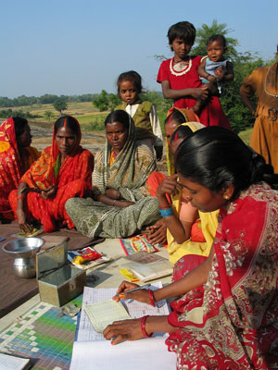
About the Loans
MFI’s (Microfinance Institutions) provide capital from donors or commercial lenders
Size: Generally 1/4-1/3 of country’s annual income
Terms: 6 months, paid weekly
Maximized impact: Funds recycled to other borrowers
Repayment: 95-98% repayment
Collateral: “social guarantee” and incentive
Notes:
MFI’s (Microfinance Institutions) provide capital from donors or commercial lenders (non or for profit).
Unlike banks, loan officers travel by foot or bike into the communities.
Size: vary depending on county; generally ¼ to 1/3 of the country’s annual income
Terms: typically 6 months, payments made weekly
Fund recycled to other borrowers, maximizing impact of money
Repayment: well-run MFI’s see 95-98% repayment; poor people lack physical collateral, but small groups ensure “social guarantee” (other members of group have to make up for it, known in the community) and incentive to get larger loans

Slide 7
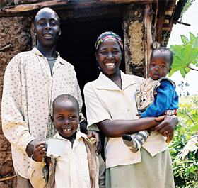
Women & Responsible Credit
80% worldwide go to women:
  More likely to have a small business
  More likely to repay
  More likely to impact whole family
  Less likely to be involved in income-negative activities
MFI’s provide training in responsible use of credit
Increasing income, not paying off other debt
Notes:
Approximately 80% of microloans made worldwide are to women: they are seen as more likely to have a small business, to repay due to commitment to the family, less likely to be involved in drinking or other income-negative activities; believe it is more likely to impact whole family
Training in the responsible use of credit and borrowing for purpose of increasing income (not paying off other debt or for consumer goods)

Slide 8
What are the Interest Rates?
Primary criticism of microfinance
Average annual rate: 28% (including fees and inflation)
Reasons for interest:
  MFI’s self-sufficiency
  Inflation
  Most include extra training or health/emergency insurance
  Many small loans make it expensive to collect
  Costs of fundraising and overseas transfers
Notes:
Average annual rate: between 30 and 50% with fees included (think 10 to 25 plus inflation)
Primary criticism of microfinance, seems high to many people but:
Reasons: MFI’s need to be self-sufficient; inflation must be accounted for; most MFI’s include training or health/emergency is built into the loan

Slide 9
Trends and Events
Donors: Difficult to secure long-term; fundraising requires time & money
Profits: MFI’s can make a profit; sometimes means higher interest or reduced services
Commercial services: MFI’s can borrow money from outside sources (i.e. banks); easier to access than donor $ but can mean higher interest or decreased services
Notes:
Donors: Can be difficult to secure long-term donors and expenses may go toward securing them
Profits: can make a profit, though sometimes at expense of higher interest rates or reduced services
Commercial services: MFI’s can borrow money from outside sources (i.e. banks) to increase loan portfolio. Easier to access than donor money but can mean higher interest or decreased services.

Slide 10
Does Microfinance Work?
MFI’s can be easily replicated
As size increases, so do overhead costs reduce
Emerging research and anecdotal evidence shows impact on communities
Seeing it in action is the best way to understand impact
Notes:
MFI’s can be replicated and scaled relatively simply in a diversity of countries and settings
As an MFI increases in size, overhead costs are reduce
Research emerging suggests that it does (examples across the world)
Seeing MFI’s in action is the best way to understand their impact on lives and communities

Slide 11
What is Christian Micro-Economic Development (MED)?
Russell Mask and David Bussau
A development strategy
  (Christian Development envisions transformation towards the Kingdom of God, whereas secular development has to do with socio-economic uplift (usually as defined by the U.N. circles)
A broad package of financial services (savings, credit and insurance)
+ development services (business training, marketing assistance, etc)
For the entrepreneurial poor
From $5 to $50,000 in capital
CMED is an integrated holistic approach

Slide 12
Transformation
Develop this phrase:
Transformation is the changes in values and perceptions which lead to a more loving pattern of action.
Values, perception are the cultural core
Relationships are the social millieu
Organization and structures are the economic context
Love is the central dynamic of Kingdom activity
So Transformation is: _____________________

Slide 13
CMED and proclaiming the Kingdom
What is missing in Busseau’s definition of its role?
Part of the strategy in discipling the nations
Addresses some physical/social needs
Community access
Facilitates evangelism and discipleship

Slide 14
CMED and proclaiming the Kingdom
His definition is not integrated, not holistic.
Rather, CMED is:
part of economic discipleship of the peoples, not a separate activity alongside it.
part of bringing them under Kingdom economic principles.
part of evangelism, the declaring the good new of jubilee, not alongside it.

Slide 15
Limits to Christian Micro-Enterprise Development
MED (micro enterprise development) became popularized in the 1990s.
Reasons for Christian Development Organizations (CDO) and CMED’s not reaching the same scope as secular counterparts
“expansion would require access to large volumes of capital that are usually available only from secular donors and equity investors…secular constraints that focus primarily on financial aspects of financial microfinance” (Bussau & Mask, 2003)
      capital as a limiting factor
      constraints of reach
      constraints in operating practices

Slide 16
Tensions for CMED Organizaitons
Secular Donors
No evangelism
Missions
Need to see how MED fits with expansion of Kingdom
Churches
See MED as just business not spiritual
Christian Donors
Commitment to holism
No discipleship
And to business success
MED sees church as not business-like
Often a narrow definition of evangelism
Narrow goals

Slide 17

Savings Cooperatives
Important note: poor people save and have been doing so in the 2/3 world for centuries, relying on informal mechanisms to save.
Difficult because life events interfere, fiestas, illnesses, natural disasters
Save in gold, crops, land, hidden cash
Informal Finance-all financial transactions, loans and deposits, occurring outside the regulation of a central monetary or financial market authority.
·Take place among people who know each other
·Relatively small amounts of money
·Multiple functions (credit + trade + commerce = insurance against risk)

Slide 18
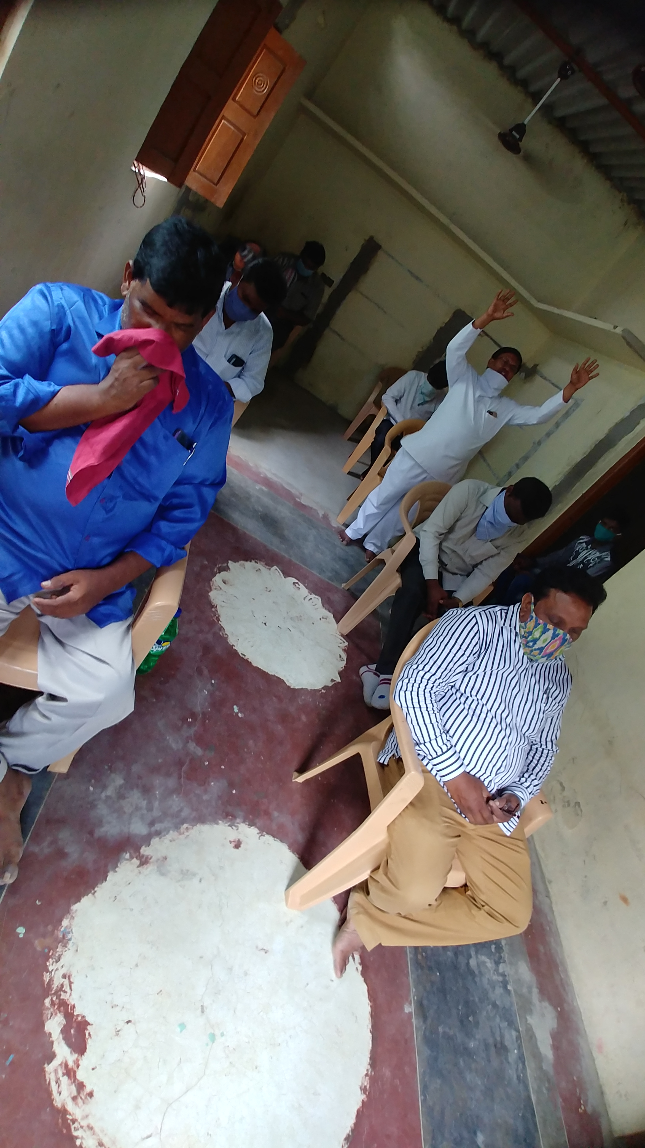
Savings Cooperatives
ROSCA (Rotating Savings and Credit Associations)
contribute weekly
15-30
Use of prize for whatever is needed, cnnsumer goods, housing, education
Fixed time length
Simple and transparent
ASCA (Accumulating Savings and Credit Associations)
Not limited in time
Examples: Cooperatives, Credit Unions, Burial Societies
As fund grows needs a manager or committee
May charge interest. 3-8% per month

Slide 19
Christian MED (Chap 2)
Implementing Vision and Mission for Christian MFI’s
Attributes of CMED
1.Supports belief in the necessity for a personal relationship with Jesus Christ
2.Foundations in Biblical worldview
3.Includes global and local church
4.Includes work for holistic development of people
5.Mission reflects understanding of multi-dimensional nature of deprivation

Slide 20
Christian MED (Chap 2)
Implementing Vision and Mission for Christian MFI’s
CMED Objectives
Open the community to experience the kingdom of God economically and spiritually
Strengthen Church via identity restoration and enablement in roles of stewards and servants
Vision and mission are critical motivators towards
spiritual transformation
microfinance objectives.

Slide 21
Limits to Christian Micro-Enterprise Development
DANGERS:
Bad implementation can be harmful to borrowers/savers, families, local churches, communities and orgs implementing MED programs
Rapid scaling up can be a strain destroying an organization if there is not capacity and structure to manage properly
CMED’s with broad vision struggle with balancing program sustainability with transformative services to the poor (ch 2)
Donors and those on front line often have differing objectives (list five, p 12)).

Slide 22
Providing MED
Promoting: Set up your own program
Providng: Sell services
Partnering: Partner with an MED provider

Slide 23
Church – Based MED
Study Table 8 and discuss different models of church relationships with MED

Slide 24
Difficult Issues with Microfinance
1. Debt as a Blessing
Banking systems are based on maximizing debt.
The scriptures are against going into debt as the borrower becomes servant to the lender.
Clearly reducing the interest rates from the money lenders is part of liberation.
But is authenticating ongoing debt positive? David Bussau believes it gives a sense of identiy and dignity to the person
How do you manage the changes to family structure and roles?

Slide 25
Is engaging people in the debtor system
(= banks) a Kingdom objective?
In 1999, after fifteen years of progress, Bolivia suffered its first serious economic setbackjust as overlending was heating up. The timing of the economic slide propelled the over-indebtedness problem to crisis proportions. Bolivia began to experience heightened social unrest, with mass protests about things like water and electricity prices.
Microfinance, too, felt the anger of the powerless. Interactions with clients started to sour, as loan officers spent more time wheedling collections from customers faced with too much debt and shrunken demand. These conditions set off a backlash against microcredit.

Slide 26
2. Potential Damage
Poorly conceived, designed, and implemented (ultimately unsustainable)
Can cause loss of assets for clients
The loan program can end up insolvent
Effective informal credit systems can be weakened
Credit cultures can be damaged
Churches can be fragmented

Slide 27
Microfinance and the Uplift of Women - Mayoux
There are four basic views on the link between micro-finance and women's empowerment:
  • there are those who stress the positive evidence and are essentially optimistic about the
  possibility of sustainable micro-finance programmes world-wide empowering women;
  • another school of thought recognizes the limitations to empowerment, but explains those
  with poor programme design;
  • others recognize the limitations of micro-finance for promoting empowerment, but see it as
  a key ingredient as important in themselves within a strategy to alleviate poverty;
  empowerment in this view needs to be addressed by other means;
  • then there are those who see micro-finance programmes as a waste of resources.
  Mayoux, Linda

Slide 28
3. Microfinance and the Uplift of Women - Mayoux
Discussion
Discuss the effects of
micro-finances on the
role of women? (the
article assumes that
all women are oppressed
in poor societies). Is
economic uplift significant
or only a stepping stone
to a wider women’s
liberation movement?
Given the Biblical values
of respect, roles, love,
mutuality in male-female
relationships in marriage
can you locate any
articles of micro-finances
on the impact on marriage
relationships?
Discuss the spiraling down
of other women’s empower-
ment initiatives in favor
of donor-loved micro-
finance programs.
There are four basic views on the link between micro-finance and women's empowerment:
  • positive evidence essentially optimistic about the possibility of sustainable micro-finance programmes world-wide empowering women
  • recognizes the limitations to empowerment, but explain those as poor program design
  • recognize the limitations of micro-finance for promoting empowerment, but see it as
  a key ingredient which needs to be addressed by other means
  • see micro-finance programs as a waste of resources.
  Mayoux, Linda

Slide 29
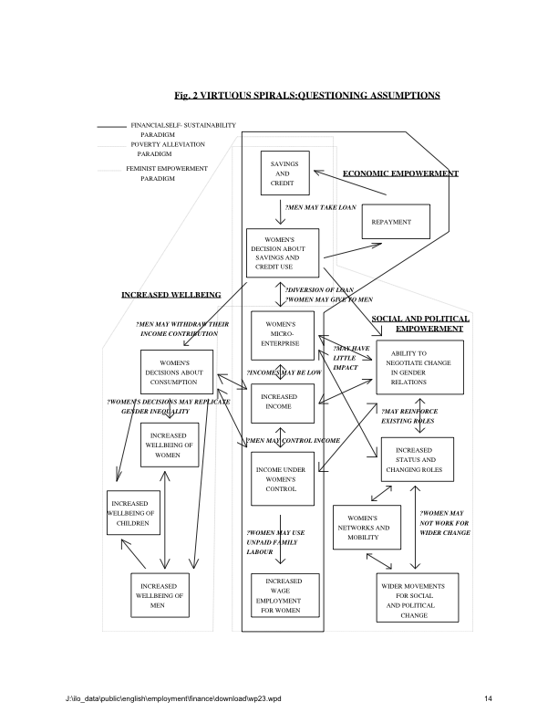

Slide 30
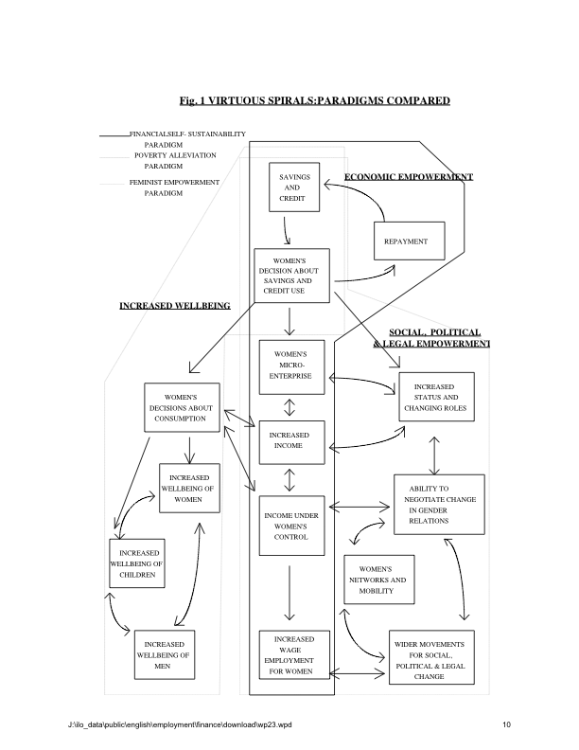

Slide 32
Readings
Christian Microfinance Principles
*Greer, P. and. Phil. Smith. (2009). The Poor Will Be Glad. Grand Rapids, Zondervan. (chap 7,8)
*Bussau, David & Russell Mask. (2003). Christian Micro enterprise development – An Introduction. Regnum Books international in Association with Paternoster Press. U.K. or WIpf & Stock or the Chalmers Centre. Start with Chapters 2 & 3. (Supplement that with the whole book if you can).
Supplemental Readings
Yunus, Muhummad (1999). Banker to the Poor: Micro-Lending and the Battle Against World Poverty 272 pages. ISBN: 1891620118 (Amazon $10.20 Kindle $9.69).
Practical Steps in Developing Micro-finance
(see also http://www.chalmers.org/work/gtc/trainers-in-the-majority-world). Evaluate the steps in the training syllabus and identify what you need to learn.
Development of Micro-finance Institutions
*Ledgerwood, J. (1999). Products & Services. Microfinance Handbook: An Institutional and Financial Perspective. Washington, The International Bank for Reconstruction and development/World Bank. (Amazon $35.59 new, kindle $13.27). Chapter 3.
Supplementary Readings
Maria Otero Elisabeth H. Rhyne, eds. (1994). The New World of Microenterprise Finance: Building Healthy Financial Institutions for the Poor . Kumarian Press. ISBN: 1565490304 318 pages.
Marguerite Robinson (2001). The Microfinance Revolution: Sustainable Finance for the Poor . World Bank, ISBN: 0821345249.
Marguerite, S. Robinson. (2002). Microfinance Revolution Volume 2: Lessons from Indonesia. World Bank. ISBN: 0821349538.
Critiques of Micro Finance Progressions
Mayoux, Linda. Micro-finance and the Empowerment of women. (Access at http://www.ilo.org/employment/Whatwedo/Publications/WCMS_117993/lang--en/index.htm)
Elizabeth Rhyne. (2001). Crisis in Bolivian Microfinance, Accion Press release.
Supplementary Reading
Elizabeth Rhyne. (2001). Mainstreaming Microfinance: How Lending to the Poor Began, Grew, and Came of Age in Bolivia. Kumarian Press, ISBN. 1565491262. 272 pages.
To glean the phases of development of the micro-finance industry it is enjoyable to read the life story of David Bussau, the Christian equivalent of Mohammad Yunus in Philippa Tyndale. (2005). Don't Look Back: The David Bussau Story. Allen & Unwin.

Slide 33

The End…

