Slide 1
Discerning & Engaging The Powers
From scripture to engagement
Viv Grigg, Oct 2017

Slide 2
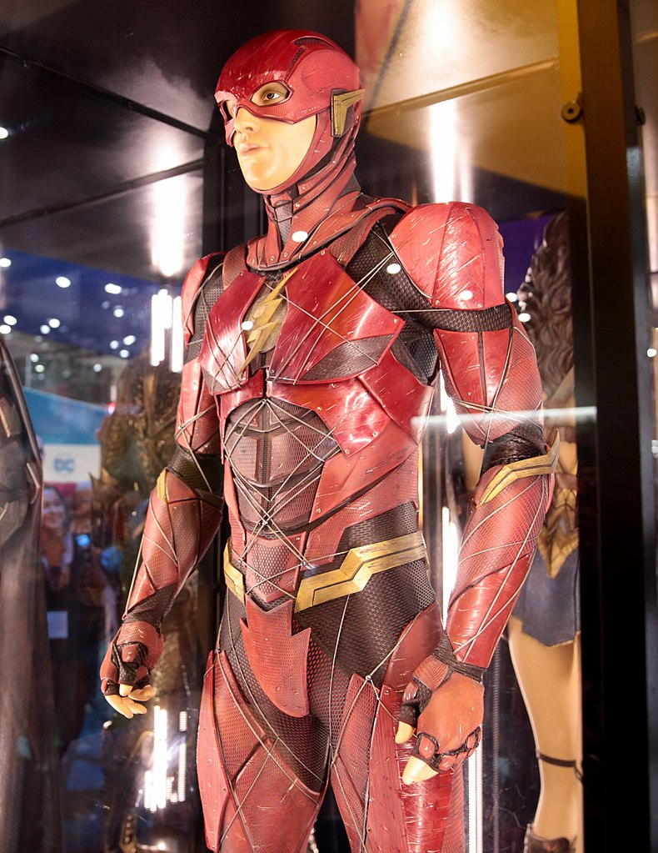

Discerning & Engaging The Powers
But this: He sustains the Universe
And appoints Principalities and Powers
These reign over earthly structures, cultures, institutions, religions
Not this!!
Fake News
From scripture to engagement
Viv Grigg, Oct 2017

Slide 3
Biblical Theologies from Contexts of Oppression
Biblical contexts of response to oppression and injustice
  Seeking Justice
  Understanding the Nature and Limits of Authority
  Understanding how mega-structures cultural configurations function
  Liberation from Oppressive Authority

Slide 4
Historic Theologies from Contexts of Oppression
Anabaptist rejection of power, as they were oppressed by State churches.
From this the Mennonites and their commitment to non-violence against the structures of domination – Wink’s trilogy.
The evangelical German responses to Hitler – Berkhof on the Powers
Latin American responses of Liberation Theology - Boff
Pentecostalism with a focus on Power

Slide 5
The Biblical Data on “Principalities and Powers”
Deut 32:8,9
Psa 82:1-4
Dan 10:13-14
Matt 12:29
Matt 24:29
Luke 12:11
Rom 8:38-39
Rom 13:1-2a
1 Cor 2:6-8
1 Cor 15:24-26
2 Cor 10:3-4
Eph 1:20-21
Eph 2:1-2
Eph 3:10
Eph 6:12
Col 1:16-20
Col 2:10
Col 2:15
Titus 3:1
1 Pet 3;22
Rev 18-21

Slide 6
What are the Powers?
Authorities, rulers, powers
‘isms, Marxism, communism, Capitalism, nationalism
Religions (Buddhism. Judaism, Hinduism, Catholicism),
Traditions (religious and cultural)
Cultures
Multinationals, global economics, WTO, UN
Militarisms, Nations and their armies
Philosophies
Higher principalities

Slide 7
Various Interpretations
Luther: the Powers are God-ordained structures we are to submit to and obey.
Sociology: The Powers are a human projection of collective human dynamics
Pentecostalism: The Powers are high level demonic spirits intruding into people who control systems
The Powers are the spiritual dimension of the social, cultural, economic and political structures that govern, part of God’s good creation but have rebelled against God (Berkhof).

Slide 8
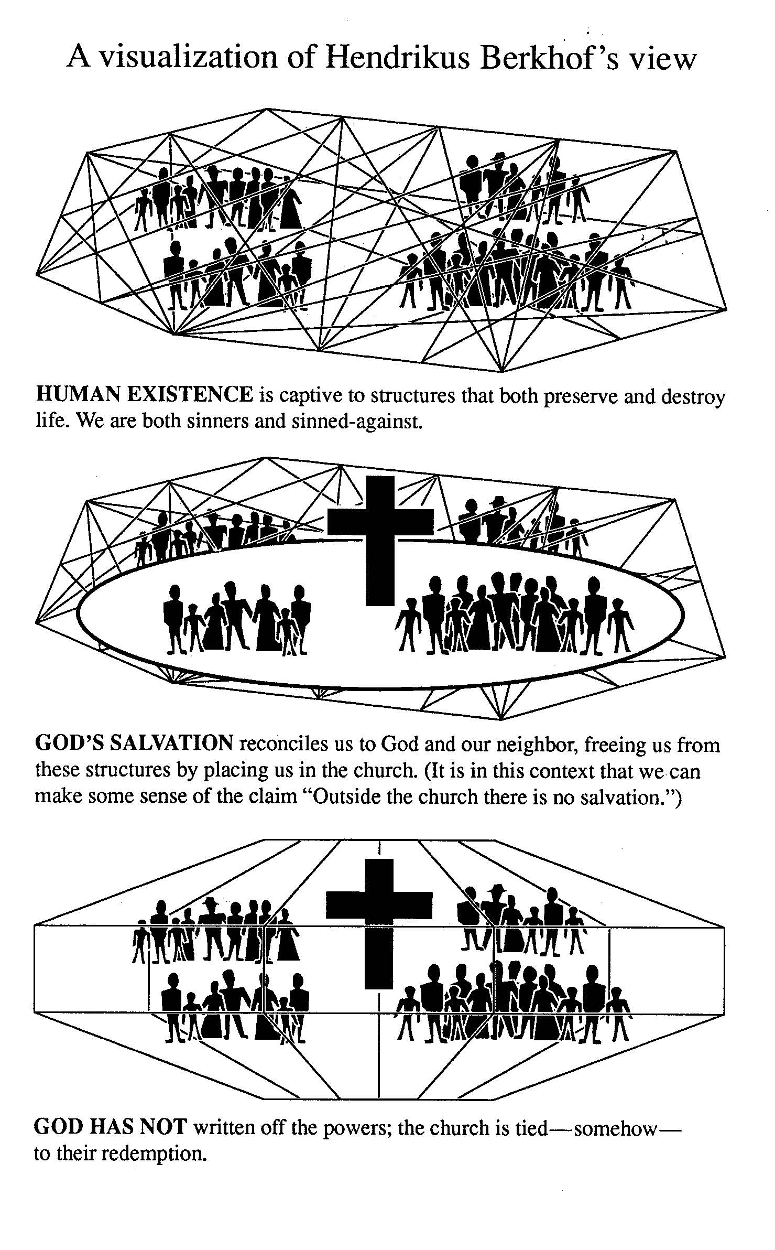
Berkhof’s Description of the Powers
Wink draws on Louis Berkhof, German theologian, who in turn draws on the German churches’ response to Naziism.

Slide 9
Responses to the Powers (Wink)
Wink, from an anabaptist perspective, with a strong commitment ot non-violence and peacemaking wrote a theological trilogy of some import:
  Naming the Powers: The Language of Power in the New Testament
  Unmasking the Powers: The Invisible Forces that Determine Human Existence
  Engaging the Powers: Discernment and Resistance in a World of Domination
The Powers are not that system (The Domination System) they are merely individual institutions and structures deployed under the overall aegis of the Domination System. The Dominations System is what obtains when an entire network of Powers becomes hell-bent on control. The Domination System is , so to speak, the system of the Powers, in a satanic parody of God, who might be called the System of the systems. The Domination System is thus equivalent to what the Bible so often means by the terms, “world”, Aeon”, and “flesh”. (Wink, Engaging, pg. 49)

Slide 10
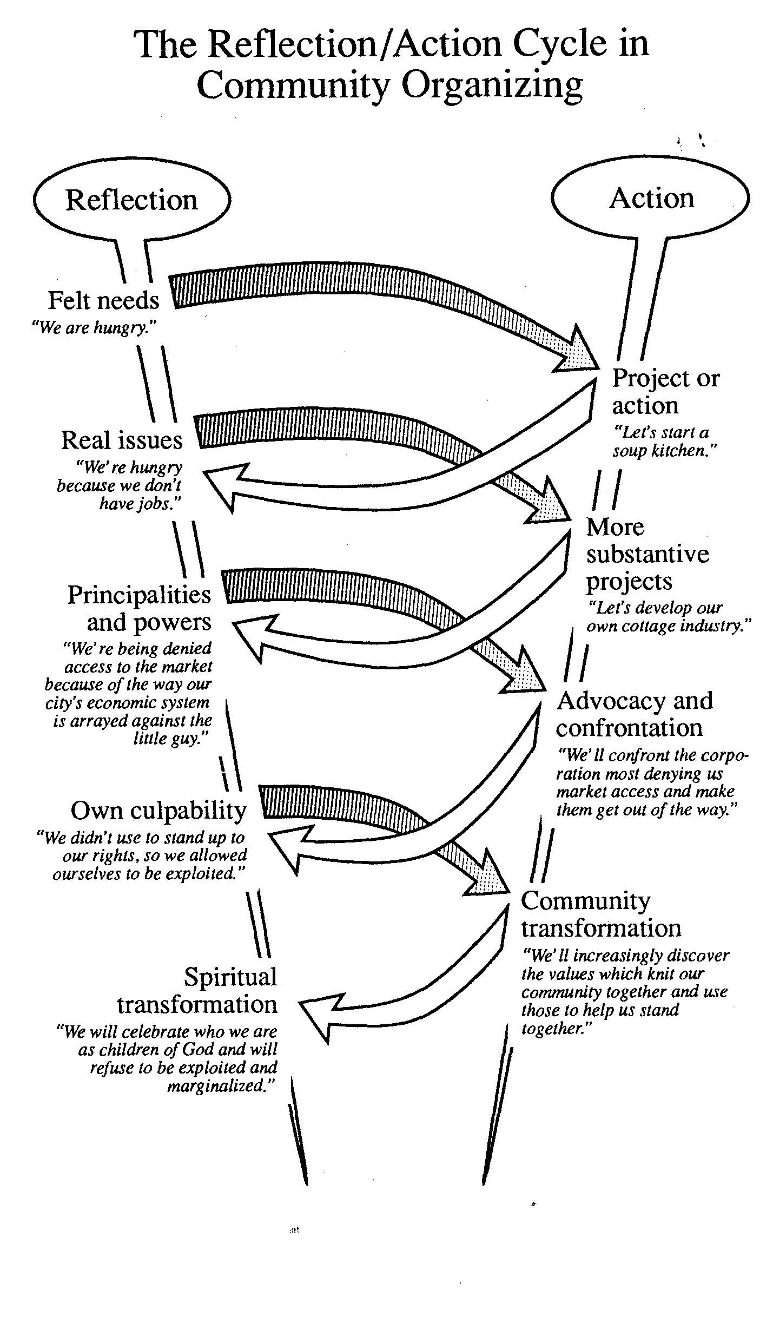
Confronting the Powers with Community Organizing e.g.Electricity, Water
Garbage, Land Rights
Bob Linthicum, studying under Saul Alinsky, brought community organizing theory and practice into evangelicalism as a practice for poor communities to engage power
From McAlpine, reflecting on Robert Linthicum

Slide 11
The Dichotomy
“The world” in the scriptures was created good. Including the structures of authority
The “world” is also a description of the fallen powers.
We are to submit to the structures God has created.
We are to avoid the world, flee the world, to resist the devil, including his intrusions into structures.

Slide 12
Christianity in Culture
Chuck Kraft as an anthropologist theologian, in Christianity in Culture, considers the structures as neutral. They are cultural configurations.
In my writings, I consider that they can be developed as godly (infused by the work of his Spirit as in creation), good, following the best in humanity, neutral as simple procedures, evil (following the worst in our humanness or created by evil men), or demonic.

Slide 13
Confronting the Powers at Critical points
In my writings, I argue that:
We can engage the powers at various levels of structural development
Thus in the educational system we can engage:
  The political decisions as to policy
  The politicians
  The educational department leadership
  The educational department systems
  The national content
  The local school boards
  The school principals
  The educators
  ANY ONE OF THESE CAN FALL ON THE SPECTURM OF GODLY, GOOD, NEUTRAL, EVIL, DEMONIZED.
  SOCIAL ANALYSIS TOOLS ARE NEEDED TO DISCERN WHICH
  STRATEGIC ANALYSIS IS NEEDED TO DISCERN HOW TO ENGAGE

Slide 14
Day to day relationship to authority
The training ground for such encounters with authorities is in our daily engagement with the structures and authorities in which we exist
n.b. this is culturally determined – each culture can be analyzed in terms of cultural distance in authority relationships, patterns of decision-making etc.

Slide 15
Relationship to Authority
Lorne Sanny, when President of the Navigators, gave a fine Biblical perspective that works for Americans and is somewhat valid cross-culturally. His themes:
What is Authority?
Submission to Authority
Exercise of Authority
Limits to the Exercise of Authority
Confronting Unjust Exercise of Authority
  `http://www.discipleshiplibrary.com/lorne_sanny.php

Slide 16
References
Berkhof, Hendrikus. (1953). Christ and the Powers. Scottsdale PA: Herald Press
Dawson, J. (1989). Taking Our Cities for God. Lake Mary, FL: Creation House.
Glasser, A., Charles van Engen, et al. (2003). God’s Kingdom Extends over the Powers. Announcing the Kingdom. Grand Rapids, MI, Baker Academic. Chap 21.
Grigg, V. (1995). Spiritual Warfare and the Poor in the Gateway Cities. In M. Wilson (Ed.), Praying Through the 100 Gateway Cities. Seattle: YWAM Publishing.
Grigg, V. (2004) With Justice for All. In Companion to the Poor. Authentic.
Grigg, V. (2009). The Spirit of Christ and the Postmodern City: Transformative Revival Among Auckland's Evangelicals and Pentecostals. Lexington, KY: Emeth Press and Auckland: Urban Leadership Foundation.

Slide 17
References
Kraft, C. (1979). Christianity in Culture: A Study in Dynamic Biblical Theologizing in Cross-Cultural Perspective. Maryknoll: Orbis Books.
Linthicum, R. (1991). City of God, City of Satan: A Biblical Theology of the Urban Church. Grand Rapids, MI: Zondervan.
McAlpine, T. H. (2003). Transformed by Osmosis. In Facing the Powers. Wipf and Stock Publishers.
Sanny, Lorne, (c 1976) Authority series. Navigators
Wink, Walter. (1992) Engaging the Powers. Minneapolis: Fortress Press.

