Slide 1
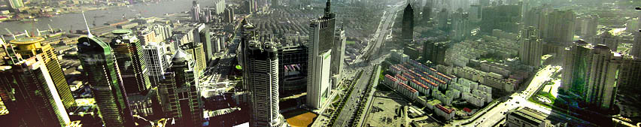
Urbanization, Postmodern Megalopolises and the Kingdom
Dr. Viv Grigg

Slide 2
Last century saw the urbanization of the world.
In the last decade, Cities have morphed into the era of Megalopolises and Conurbanisations.
The Kingdom has exploded globally
Kingdom principles are deeply affecting economic, political and social structures globally

Slide 3
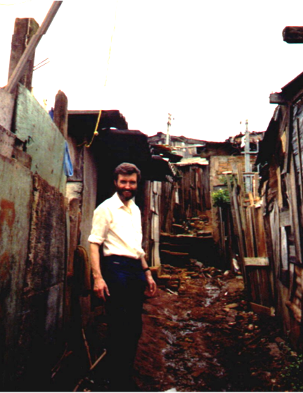

1. Personal Pilgrimage
Heliopolis, 1988
Following Christ
Living in the Slums & Favelas of
* Manila, Philippines
* Kolkata, India
* Heliópolis, São Paulo
* NW Pasadena, Los Angeles
* Kelston, Auckland
In answer to prayer, God has given
  Movements of churches,
  development agencies, advocacy groups
  missions
  global networks which include
  the Aliança Encarnação de Lideres de Movimentos entre os Pobres
  training processes

Slide 4

2. The Urbanizing God
The beginning of adventures in transformation is in spiritual formation:
Scriptures begin in a garden and end in a city
The garden remains in the city
The city is predicted by the nature of God himself –community, communicating, creating, producing, artistic…
The river of the Holy Spirit flows life to the city
Take out the Holy Spirit, and you have deathly cities.

Slide 5
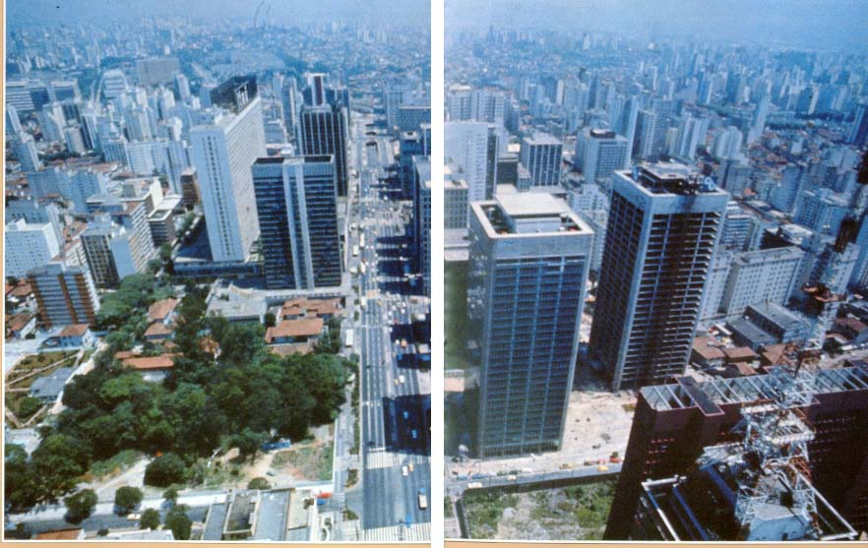
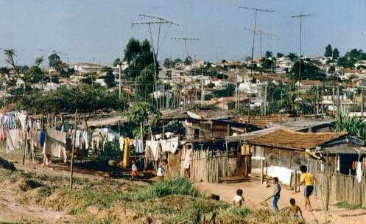
4000 year old Abrahmic dream
The Biblical Tale of Two Cities
He looked forward to a city, whose builder and maker was God
City of Beauty,
Equality, Love
& Prosperity

Slide 6
3. Critical Progressions: Conurbanism
Urbanization is process of city migration and growth.
Urbanism is the development of city culture
Issues beyond Urbanism: What does
  1. A post-Postmodern Conurbanism look like?
  2. A Kingdom-transformed Megalopolis look like?
Our task to bring the city of God into the City of Man

Slide 7
Emergent Polarizations
Socio-geography of Postmodern city
Two tiered cities
Stock Exchange
Politico-Economic polarization
Culture of megalopolis
Informal Migrant Economy
Slums
Trailer parks
Multi-family
Politics of Nature
Expansion of Dear, L.A. as Postmodern Urbanism

Slide 8
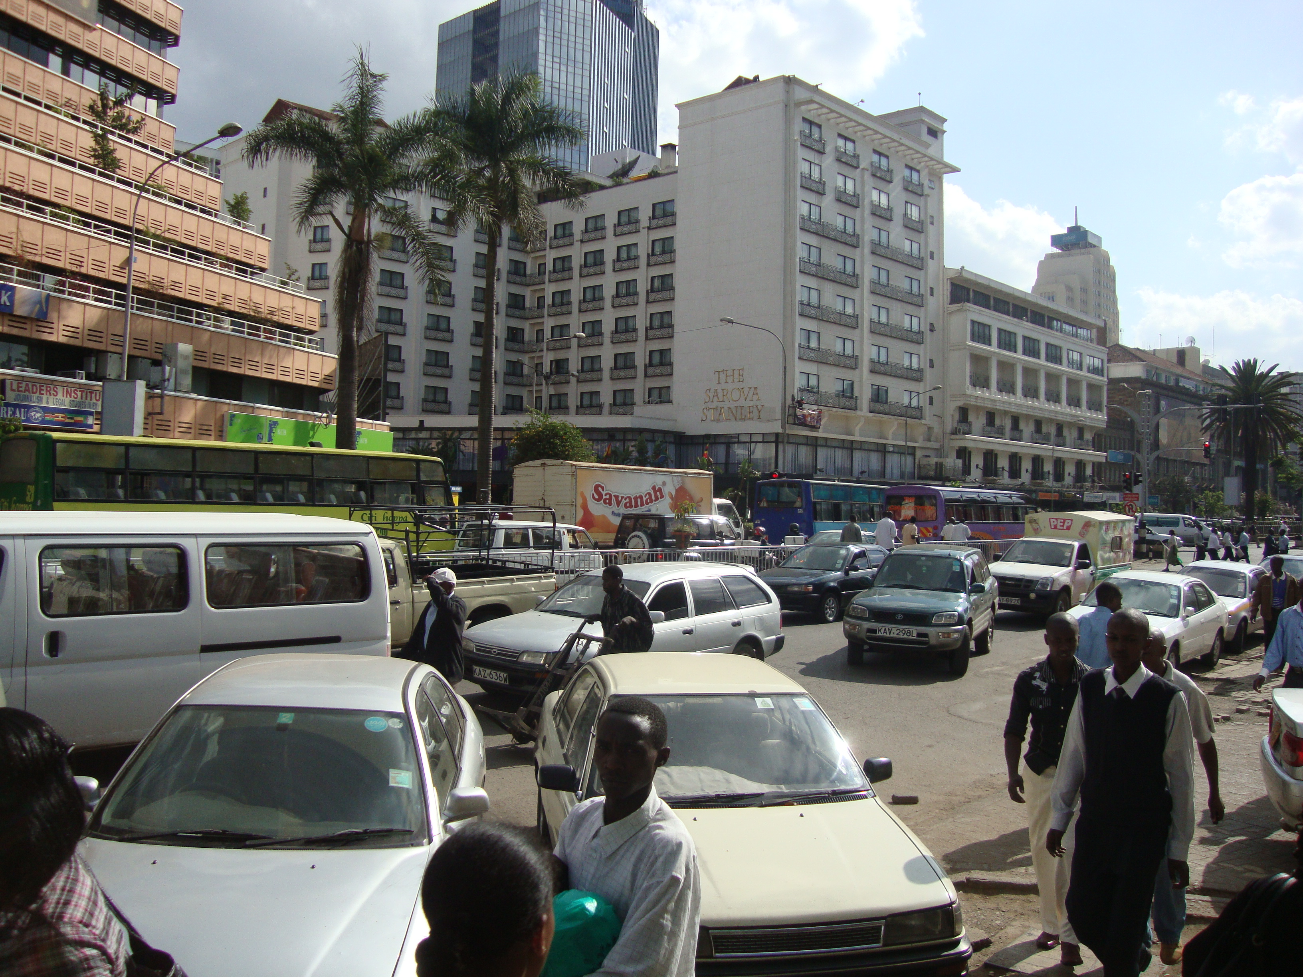
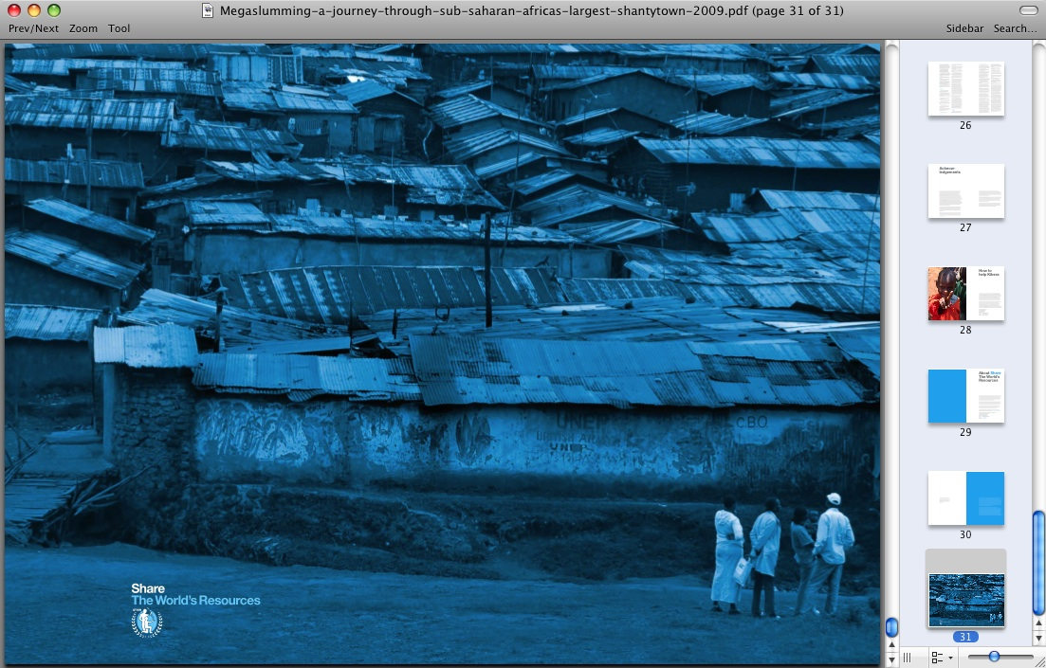
Third World Conurbanizations
1.3 billion in slums today
2 billion by 2025
All population increase to slums

Slide 9
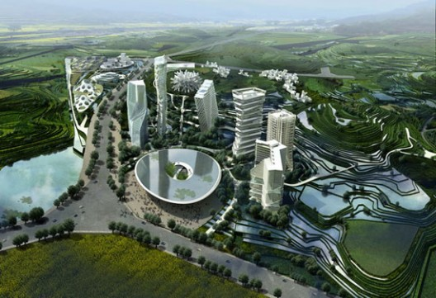
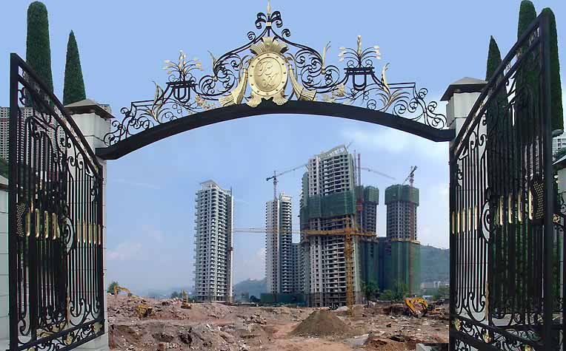
Chinese Postmod-ernism
Cities Without History
Chinas new cities
http://www.archdaily.com/category/urban-design/page/5/

Slide 10
Cities Without History
A former nation of farmers, China is halfway becoming an empire of citizens. Dusty roads are turning asphalt, carts turn into cars and concrete apartment blocks are replaced by pink and lavender condominiums. Within a decade the tidal wave of modernizations has spilled far beyond China’s coastal regions across the nation’s grey green landscape. Many thousands of villages have doubled in size and the plans for hundreds of entirely new cities are prepared and ready, awaiting execution.
http://www.archdaily.com/category/urban-design/page/5/

Slide 11
4. Urban Economic Disconnect: Informal Economies
If it takes 13 years to go through the 360 legalization processes
to start a business, how else can you survive but to be illegal
If you are illegal
how can you
create capital?
Of the 29 Causes of Cities of Poverty
Three factors are significant in dual economies:
Culture of Corruption
Dysfunctional Governance
Bureaucratization
Read Hernando de Soto

Slide 12
5. Marginalization Theory
Shadow Cities
Jesus and Shadow Cities

Slide 13
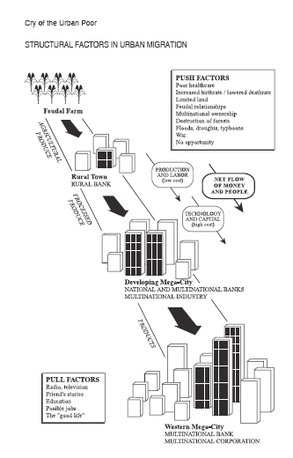
6. structural factors in urban migration
Tribal community to peasant village to feudal society to rural town to megacity to Western banking centre.

Slide 14
structural factors in urban migration
Tribal community to peasant village to feudal society to rural town to megacity to Western banking centre.

Slide 15
structural factors in urban migration
Tribal community to peasant village to feudal society to rural town to megacity to Western banking centre.

Slide 16
A just urbanization gradient
3-10% margin
Kingdom Alternatives
3-10% margin
3-10% margin
If God is in urbanization then at each step in the urbanization process there can be justice. There are just urbanization progressions.

Slide 17
A just urbanization gradient
Kingdom Alternatives
Jane Jacobs
If God is in urbanization then at each step in the urbanization process there can be justice. There are just urbanization progressions.

Slide 18
Dependency Theories
7. Dualism Theories: Skyscraper as symbol
Initially cities as outposts of industrialization by European empires (agricultural exports < manufacturing tools)
Demonstration effect of manufactured goods made cities dependent by debt mechanisms to Western, Japanese, Global banks, IMF, World Bank
Cities of Power and Wealth in a sea of poverty
Multinational exploitation in the name of law and justice backed by creation of unreal money (leveraging each dollar 40-50 times its worth)
Command centre for international trade
Skyscrapers
Shantytowns

Slide 19
Dependency Theories
Shantytowns
Slums, bidonvilles, favelas, pueblas jovenes…
40 years behind the slums an exponential growth of street children, HIV/AIDS, Slavery
Once dispossessed where can you go?
Skyscrapers
Shantytowns

Slide 20
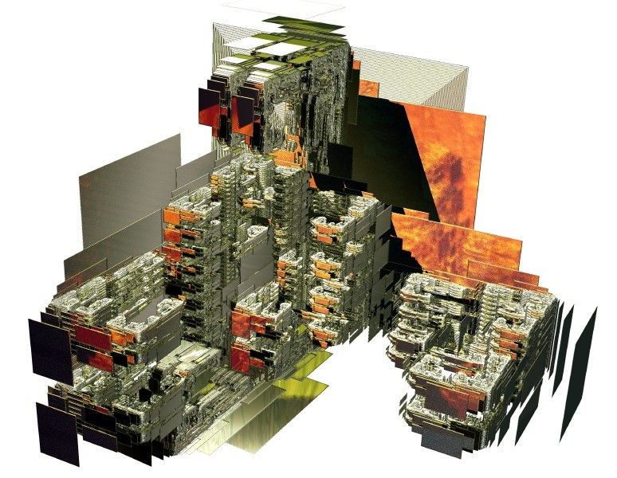
If the Kingdom Determined
Post-Post-modern
Culture…??

Slide 21
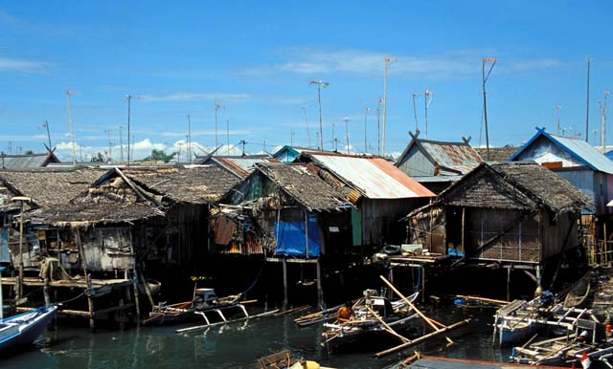
Biblical Urbanization
As a Christian responding to injustices within the urbanization process, I am affirming some moral views:
1. A transition from a two-level economic and social system to a unitary system is a desirable goal (based on the principle of being our brother’s keeper, of reconciliation between peoples, of the equality of men before God).
2. Modernization is a desirable and Biblical goal (based on the mandate to manage the earth).
3. Urbanization is a desirable goal, for God is a community and seeks community. Scripture begins in a garden but ends in a city. Although there is conflict between the city of Babylon and the city of Jerusalem in the Scriptures, we may still affirm there is a godly pattern of urbanization implied in the Bible.
4. Something similar to a middle-class lifestyle is a just goal (derived from the principle of every family having enough for their needs and development).
5. Each family has the right to own its own land, and to have a place of security.
6. The flow of economic wealth from farm to the city is a result of the fruitfulness of the earth, and a good process, but such a process requires justice at every step.

Slide 22
Macro-economic development and slums
The consequence of dependency and these processes of modernization is the emergence of slums and squatter areas.
The implications for a ministry to the poor are obvious. One may work extensively for the uplift of the urban poor through spiritual transformation, and this is primary. But the issues of unemployment, macro-level oppression and economic injustice in the fabric of the society must be dealt with at that level for the eventual freedom of the poor from their bondage.
Thus we may work hard to uplift the poor in the local community and completely fail, for the critical factor in terms of job production is primarily determined by the macro-economic development of the city.

Slide 23
From a New World Order of Oppression & Destruction to an Alternative Kingdom Order
Building on Evangelism and Revival (for without the chruch there is people resource base:
Defense of the Marginalized
Affirmation of Cultures, Tribes and localised self-sustaining economies
Creation of Public Space for pluralism (as in Egypt, not Libya)
Diffusion of economic, social, political power through multiplication of small religious, political and economic cooperative systems dijoint from the global banking systems

Slide 24
References
Davis, M. (2006). Planet of the Slums. London and NY, Verso.
de Soto, H. (2003). The Mystery of Capital: Why Capitalism Triumphs in the West and Fails Everywhere Else, Basic Books.
Dear, M. J. (2000). The Postmodern Urban Condition. Oxford, Blackwell Publishers. Global, Urban, Postmodernism,
Grigg, V. (2004). Cry of the Urban Poor. London, Authentic Press.
Mangin, W. (1967). Squatter Settlements in "Cities: Their Origin Growth and Human Impact.".
---, Ed. (1970). Peasants in Cities: Readings in Anthropology of Urbanization. Boston, Houghton Mifflen.
Perlman, J. E. (1976). The Myth of Marginality, Urban Poverty and Politics in Rio de Janiero. Berkeley, Los Angeles, London, University of California Press.
Soja, E. (1989/1997). Postmodern Geographies: The Reassertion of Space in Critical Social Theory. London, Verso Books.
Soto, H. D. (1990). The other path. New York, Harper & Row Publishers.

