Slide 1

International Development
Equality
Equity
Justice
Freedom
And the KINGDOM of GOD

Slide 2

DEVELOPMENT DEVELOPS FROM THE SCRIPTURES
In the Beginning…
If there is no beginning there is no ending, so there is no development.
HE HOVERED OVER CHAOS, AND FORMED…
The cycles of Hinduism do not lead to development.
DEVELOPMENT IS PART OF A RATIONALISTIC MODERNITY WHICH BUILDS FROM CHRISTIAN ROOTS

Slide 3
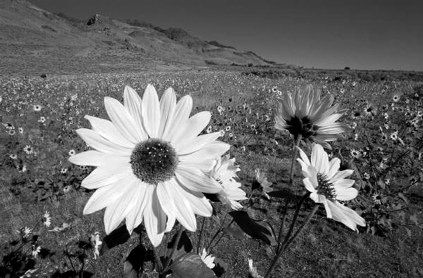
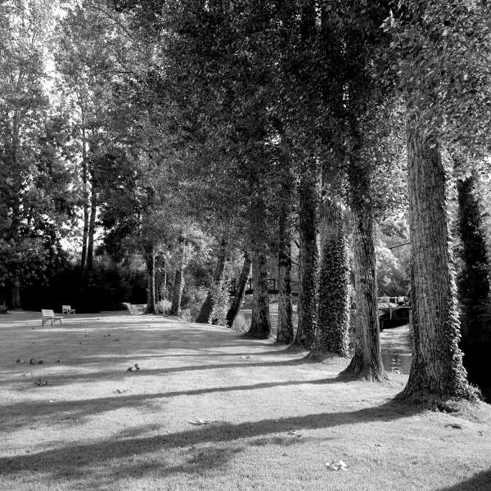
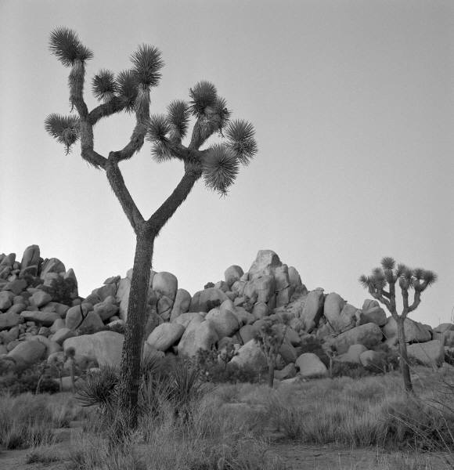
Secular Definition of Economic Development
…increasing GDP (Gross Domestic Product)
Secular Definition of Development
…making life better for all
…human flourishing

Slide 4


DEBATABLE DEVELOPMENT
For all??? Egalitarian, Equity, Equality
Or Benefitting the nations wealthy?
An ideal??? Politicians Platitudes?
Or realism?
A Better Life?
What does a better life look like??? Like America???

Slide 5
The Kingdom of God is the rule and reign of God, for the redemption of humanity and restoration of creation – Dyrness
The Kingdom of God is the highest good - Rauschenbusch.
Development is the reflection of Kingdom social-economic-political principles beyond the church demonstrating principles of redemption of humanity and restoration of creation.
Secular Development theory is a reflection, a mirror, of the principles of the Kingdom of God into societal structures.

Slide 6
Development is a natural belief of the enlightenment. Rationality can change the world for the better, utilizing all the advances of science and technology, democracy and social organization, rationalized ethics and values.
Economic growth (GDP) may produce development. Or it may channel money to the rich – a travesty for developmentalist ethics.

Slide 7

Postmodernist Critiques of Development
Growth?
Or the conditions for production and
distribution that improve the environment
and liberate humanity.
Human emancipation (Development as Freedom – Sen). Or increasing control by ruling classes over human production and freedoms.
But are modernity, reason, consumption good?
Is development theory best in terms of theory, but the worst in terms of actuality?

Slide 8
4.3 Definitions of Development
“Development is a process that enables people to consider, choose, and implement alternatives for their lives that are consistent with God’s intentions for mankind...This development process must promote self-reliance in meeting basic individual and community needs; it should progress toward the equitable distribution of human, economic, and material resources; and it should provide each person an opportunity for fuller participation in the economic and political life of his country, providing personal life-experiences which are consistent with God’s intentions for humankind.”
Dr. Art Beals, former President of World Concern
Beyond Hunger. Portland: Multnomah Press, 1985 (p.87).

Slide 9
The process of Appreciative Inquiry
2 Dream
3 Dialogue
4 Delivery
1 Discovery

Slide 11


